Slide 1

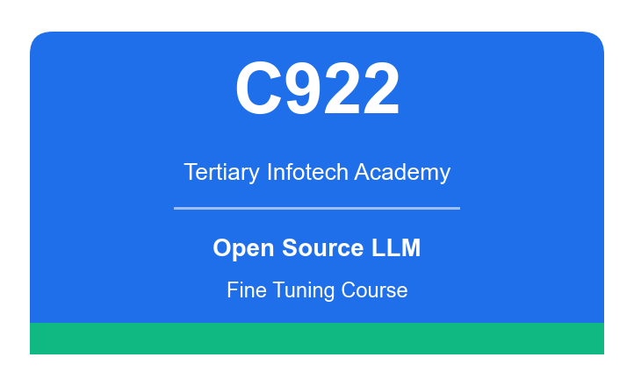
COURSE SLIDES · NON-WSQ
Fine Tuning Open Source LLM
Course Code: C922
Conducted by Tertiary Infotech Academy Pte Ltd · UEN 201200696W
Version v1.0 · 2 October 2026
© 2026 Tertiary Infotech Academy Pte Ltd. All rights reserved. · www.tertiarycourses.com.sg

Slide 2
COURSE ADMINISTRATION
Welcome & Housekeeping
Fine Tuning Open Source LLM · C922
© 2026 Tertiary Infotech Academy Pte Ltd
2

Slide 3
YOUR TRAINER · GENERAL
About the Trainer
NAME
____________________________________________
?
TITLE / DESIGNATION
____________________________________________
QUALIFICATIONS
____________________________________________
Your Trainer
AREAS OF EXPERTISE
____________________________________________
General Trainer template —
to be completed by the trainer
TRAINING & INDUSTRY EXPERIENCE
____________________________________________
CONTACT
____________________________________________
Fine Tuning Open Source LLM · C922
© 2026 Tertiary Infotech Academy Pte Ltd
3

Slide 4
YOUR TRAINER
About the Trainer
ROLE
Principal Trainer, Tertiary Infotech Academy Pte Ltd
AA
EXPERTISE
Generative AI, large language models, model fine tuning and applied machine learning.
DELIVERS
Courses on generative AI, LLM application development, data science and MLOps.
Dr. Alfred Ang
QUALIFICATIONS
PhD; ACTA / DACE certified; 20+ years in AI and digital transformation.
Principal Trainer
Tertiary Infotech Academy Pte Ltd
FOUNDER
Founder and lead instructor at Tertiary Infotech / Tertiary Courses.
Fine Tuning Open Source LLM · C922
© 2026 Tertiary Infotech Academy Pte Ltd
4

Slide 5
ICE-BREAKER
Let's Know Each Other
Who you are
Your name, your organisation and your role.
Your Python background
Your experience with Python, PyTorch and the Hugging Face libraries, if any.
1
2
Your AI background
Have you used an LLM API, or trained or fine-tuned a model of your own before?
What you want to build
What would you like to fine-tune a model to do after this course?
3
4
Fine Tuning Open Source LLM · C922
© 2026 Tertiary Infotech Academy Pte Ltd
5

Slide 6
HOUSEKEEPING
Ground Rules
Set your mobile phone to silent mode.
Participate actively — no question is too small.
1
2
Mutual respect: agree to disagree.
One conversation at a time.
3
4
Be punctual; return from breaks on time.
Full attendance — stay for the whole day to get the most from the course.
5
6
Fine Tuning Open Source LLM · C922
© 2026 Tertiary Infotech Academy Pte Ltd
6

Slide 7
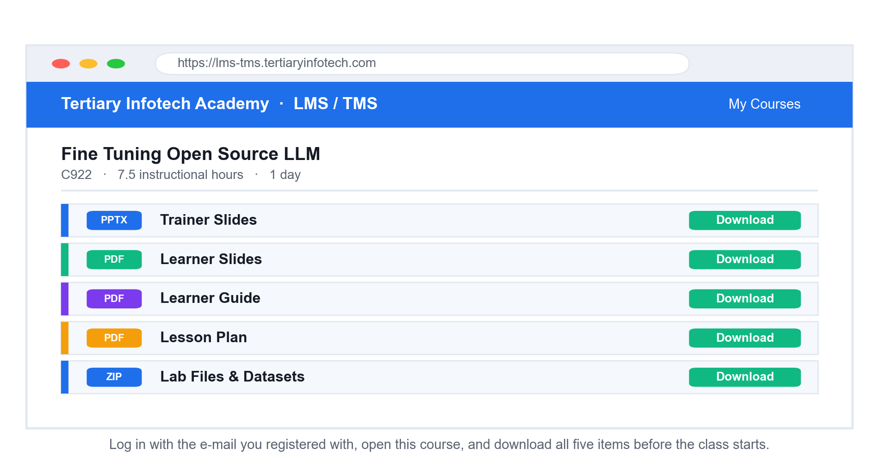
LMS / TMS · lms-tms.tertiaryinfotech.com
Download Your Course Material
Log in with your registration e-mail, open this course, and download all five items.
Fine Tuning Open Source LLM · C922
© 2026 Tertiary Infotech Academy Pte Ltd
7

Slide 8
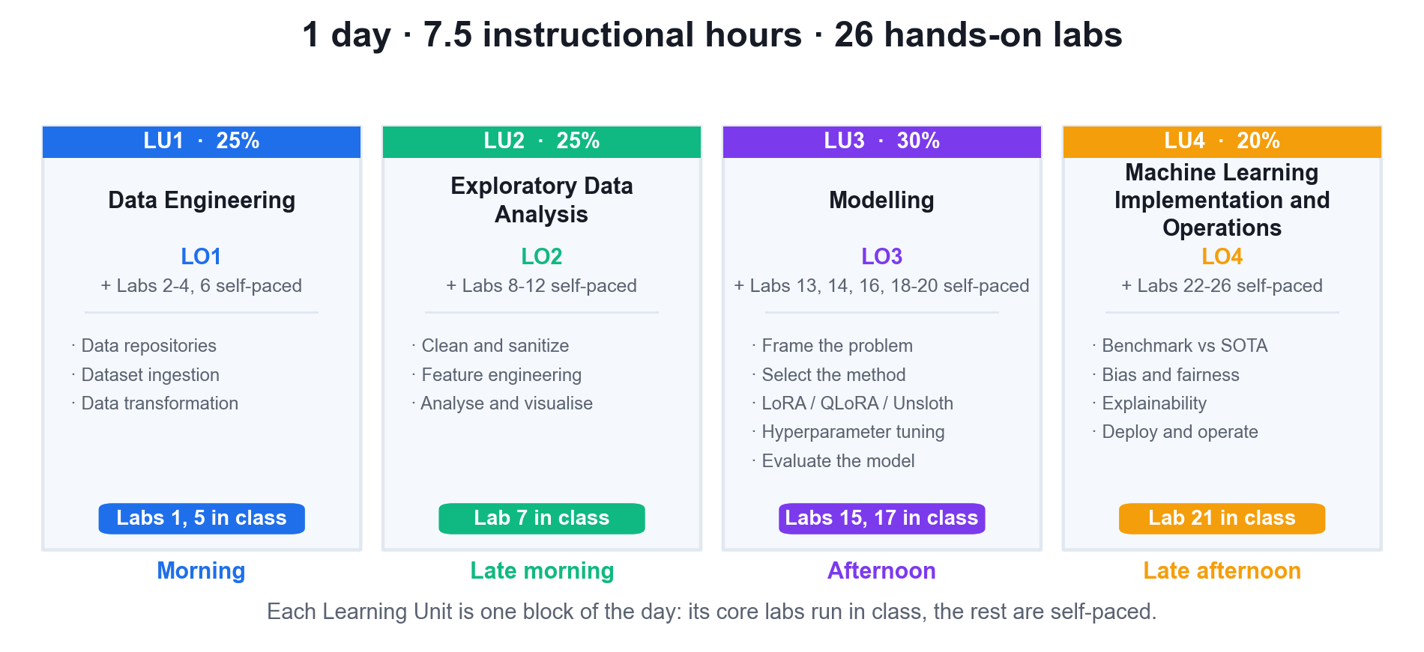
WHAT WE COVER
Course Map — Four Learning Units, One Day
Each Learning Unit is one block of the day: its core labs run in class, the rest are self-paced.
Fine Tuning Open Source LLM · C922
© 2026 Tertiary Infotech Academy Pte Ltd
8

Slide 9
SCHEDULE
Lesson Plan — 1 Day, 9:30am – 5:30pm
Morning
Afternoon
• 9:30am – 12:25pm
– Welcome · course orientation · core concepts
– LU1: Data Engineering — Labs 1 and 5 in class
– LU2: Exploratory Data Analysis — cleaning and sanitisation
– Lab 7 in class
– Lunch · 12:25pm – 12:55pm
• 12:55pm – 5:30pm
– LU2 continued: feature engineering, analysis and visualisation
– LU3: Modelling — LoRA, QLoRA and Unsloth · Labs 15 and 17 in class
– LU4: benchmarking, bias, explainability and deployment · Lab 21 in class
– The other 20 labs are self-paced extension work
– Course recap · Q&A · Course Feedback
Fine Tuning Open Source LLM · C922
© 2026 Tertiary Infotech Academy Pte Ltd
9

Slide 10
FOUR LEARNING UNITS · 26 HANDS-ON LABS
Course Outline
1
LU1 — Data Engineering
Data repositories for fine tuning · dataset ingestion · synthetic data generation · transformation into chat/instruction format
2
LU2 — Exploratory Data Analysis
Cleaning and sanitisation · optimisation strategies for higher-quality outputs · feature engineering · ETL pipelines · analysis and visualisation
3
LU3 — Modelling
Framing the fine-tuning problem · multi-modal embeddings · LoRA and QLoRA · Unsloth · training and monitoring · hyperparameter optimisation · advanced loss metrics
4
LU4 — Machine Learning Implementation and Operations
Benchmarking against state of the art · explainability and interpretability · bias and fairness · continuous pre-training pipelines · deployment
Fine Tuning Open Source LLM · C922
© 2026 Tertiary Infotech Academy Pte Ltd
10

Slide 11
LAB ENVIRONMENT
Set Up Before We Start
Google account
Sign in to Google Colab at https://colab.research.google.com — a free T4 GPU is all you need.
Select a GPU runtime
Runtime > Change runtime type > T4 GPU. Every lab assumes an attached GPU.
1
2
Install the stack
pip install unsloth, then --no-deps trl peft accelerate bitsandbytes.
Hugging Face account
Free account at huggingface.co for datasets and for pushing your adapter.
3
4
Lab files
Download the labs ZIP from the LMS — each lab folder carries its own mock dataset.
No local GPU needed
Kaggle (2× T4) or a local NVIDIA GPU with 12GB+ VRAM also work.
5
6
Fine Tuning Open Source LLM · C922
© 2026 Tertiary Infotech Academy Pte Ltd
11

Slide 12
CORE CONCEPTS
Why Fine Tuning, and What LoRA Actually Does
Fine Tuning Open Source LLM · C922
© 2026 Tertiary Infotech Academy Pte Ltd
12

Slide 13
FOUNDATIONS
What is a Large Language Model?
A model of language
An LLM such as Llama, GPT or Claude is trained to understand and generate human language.
Why 'large'
Large in training data and in parameter count — from one billion to hundreds of billions.
1
2
Autoregressive
It predicts the next token, one at a time, conditioned on everything written so far.
Pre-trained, then adapted
Pre-training builds general capability; adaptation makes it useful for YOUR task.
3
4
Fine Tuning Open Source LLM · C922
© 2026 Tertiary Infotech Academy Pte Ltd
13

Slide 14
PRE-TRAINING · WHY YOU DON'T DO THIS
How a Base Model Is Created
1
2
3
4
5
▶
▶
▶
▶
Collect a web-scale text corpus
Self-supervised next-token training
Costing millions of GPU-hours
Producing a general base model
Which you then adapt cheaply
Fine Tuning Open Source LLM · C922
© 2026 Tertiary Infotech Academy Pte Ltd
14

Slide 15
THE ECONOMICS
You will never pre-train. You will always adapt.
Pre-training a base model costs millions of dollars. Adapting one to your domain, style and format costs a few dollars of GPU time — and that gap is what this course is about.
Fine Tuning Open Source LLM · C922
© 2026 Tertiary Infotech Academy Pte Ltd
15

Slide 16
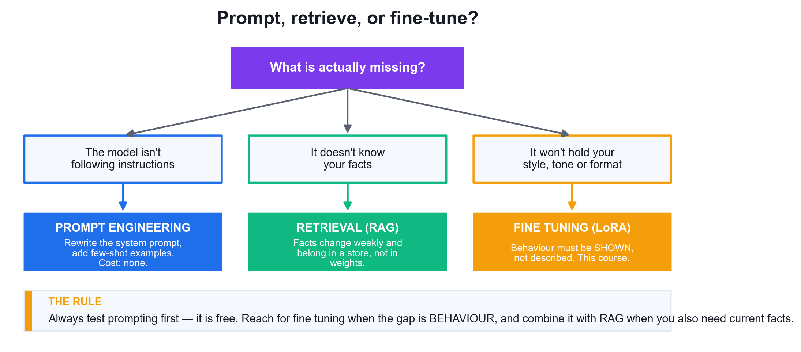
LO3 · THE FIRST DECISION
Prompt, Retrieve, or Fine-Tune?
Choosing wrongly is the most expensive mistake in the field. Diagnose what is MISSING before you spend anything.
Fine Tuning Open Source LLM · C922
© 2026 Tertiary Infotech Academy Pte Ltd
16

Slide 17
LO3 · CHOOSING THE RIGHT TOOL
Three Ways to Adapt a Model
Approach
Fixes
Cost
Latency
When to use it
Prompt engineering
Instruction following
None
Worse (long prompt)
Always try this first
Few-shot prompting
Output format
None
Worse (examples in prompt)
A handful of examples suffice
RAG
Missing or changing facts
Low
Worse (retrieval hop)
Knowledge changes weekly
LoRA fine tuning
Style, tone, format, behaviour
Low (1 GPU)
Best (short prompt)
Behaviour must be shown
Full fine tuning
Same as LoRA
Very high
Best
Rarely justified
WHEN IT MATTERS Fine tuning teaches BEHAVIOUR. It does not reliably teach FACTS — facts belong in retrieval, where they can be updated without retraining.
Fine Tuning Open Source LLM · C922
© 2026 Tertiary Infotech Academy Pte Ltd
17

Slide 18
LO3 · DESIGN DECISION
Should You Fine-Tune This Problem?
YES — prompt or RAG first
Can you describe
the desired behaviour
in a prompt?
If a system prompt and a few examples get you there, stop. It is free, instant, and there is nothing to maintain. Add RAG if the gap is missing facts.
NO — fine-tune it
If the behaviour must be SHOWN through hundreds of examples rather than described, that is exactly what fine tuning is for. This is the case throughout this course.
A useful test: if you cannot write the rule down, but you can show fifty examples of it, you have a fine-tuning problem.
Fine Tuning Open Source LLM · C922
© 2026 Tertiary Infotech Academy Pte Ltd
18

Slide 19
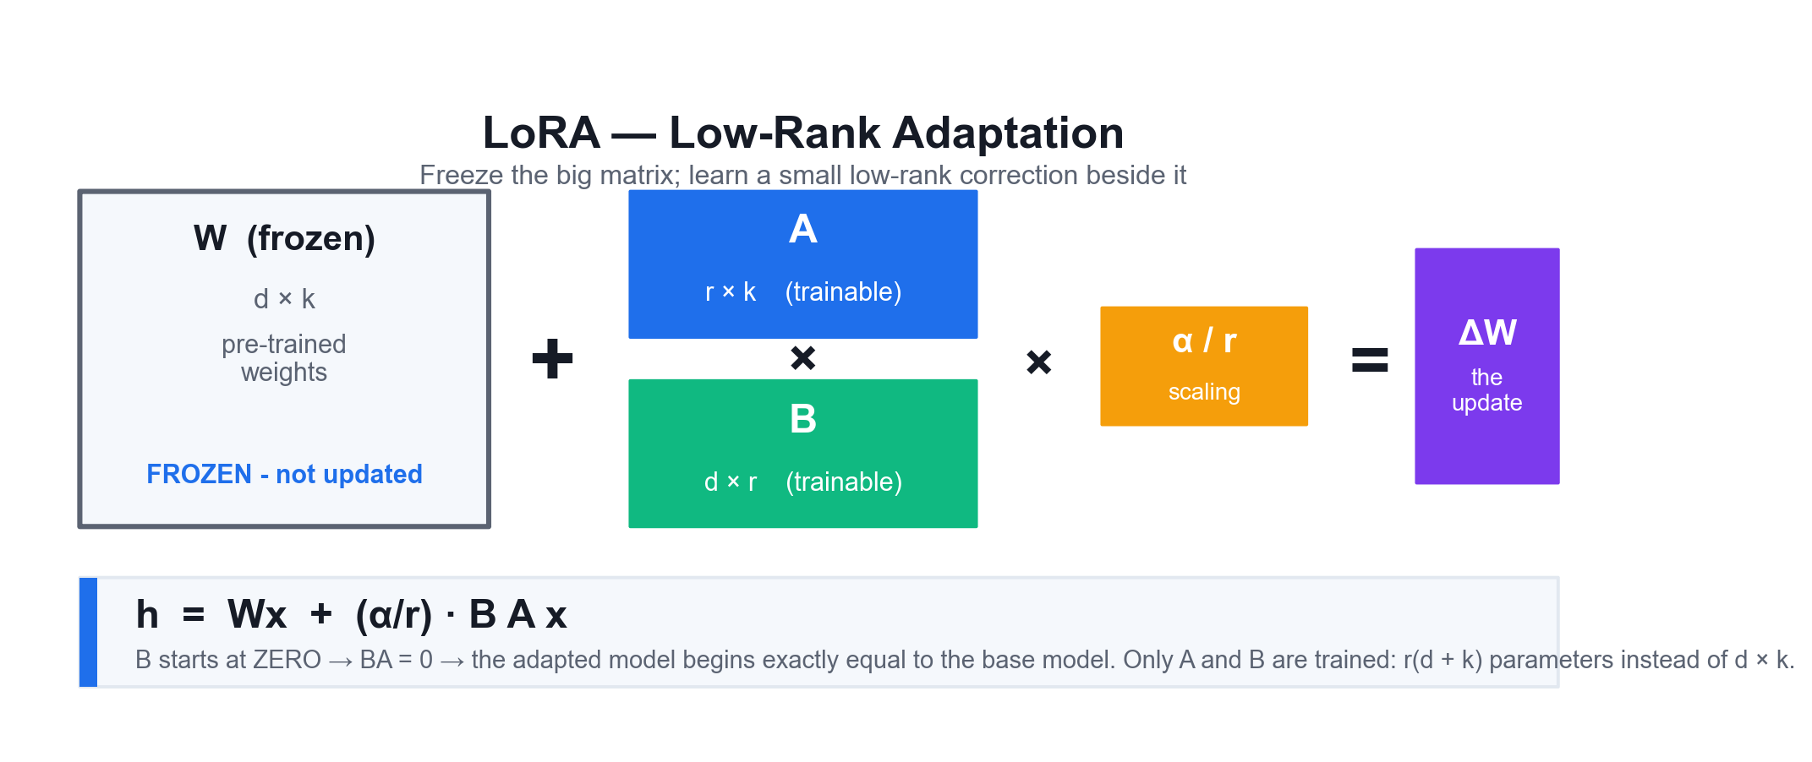
LO3 · THE CORE MECHANISM
LoRA — Low-Rank Adaptation
Freeze W. Learn two small matrices beside it. Because B starts at zero, training begins as an exact no-op and only ever adds.
Fine Tuning Open Source LLM · C922
© 2026 Tertiary Infotech Academy Pte Ltd
19

Slide 20
LO3 · WHAT YOU ACTUALLY CONFIGURE
The Four LoRA Parameters That Matter
r — the rank
Adapter capacity. 8–16 for style and format; 32–64 for genuinely new domain skills.
lora_alpha
Update strength through the α/r scaling factor. A common default is alpha = 2r.
1
2
target_modules
WHERE adaptation happens. Attention-only underfits; ALL linear layers is what works.
lora_dropout
Regularisation on the adapter input. 0 is optimised in Unsloth; 0.05 is a safe default.
3
4
bias
Whether bias terms train. 'none' is standard and is the optimised path.
use_rslora
Scale by α/√r instead of α/r, keeping the update stable as the rank rises.
5
6
Fine Tuning Open Source LLM · C922
© 2026 Tertiary Infotech Academy Pte Ltd
20

Slide 21
LO3 · WORKED EXAMPLE
Reading a LoRA Configuration
Every fine-tune in this course is configured by these fields — learn to read them once.
from peft import LoraConfig, get_peft_model
config = LoraConfig(
r = 16,
lora_alpha = 32, # alpha/r = 2.0
lora_dropout = 0.05,
bias = 'none',
task_type = 'CAUSAL_LM',
target_modules = [
'q_proj','k_proj','v_proj','o_proj',
'gate_proj','up_proj','down_proj',
],
)
model = get_peft_model(base_model, config)
r = 16
Each adapted layer learns 16·(d_in+d_out) parameters instead of d_in·d_out.
lora_alpha = 32
The update is scaled by α/r = 2.0 before being added to Wx.
target_modules
Attention AND the MLP projections. Attention-only is the classic mistake.
task_type
CAUSAL_LM tells PEFT which head and label-shifting convention to use.
Fine Tuning Open Source LLM · C922
© 2026 Tertiary Infotech Academy Pte Ltd
21

Slide 22
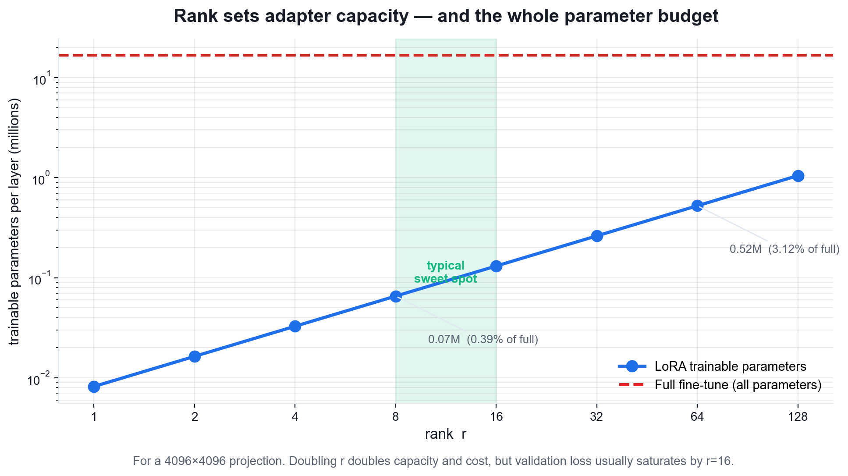
LO3 · CHOOSING r
Rank Sets Capacity — and the Whole Budget
Capacity rises linearly with r, but validation loss usually saturates by r=16. Raise the rank only when the task needs genuinely new skills.
Fine Tuning Open Source LLM · C922
© 2026 Tertiary Infotech Academy Pte Ltd
22

Slide 23
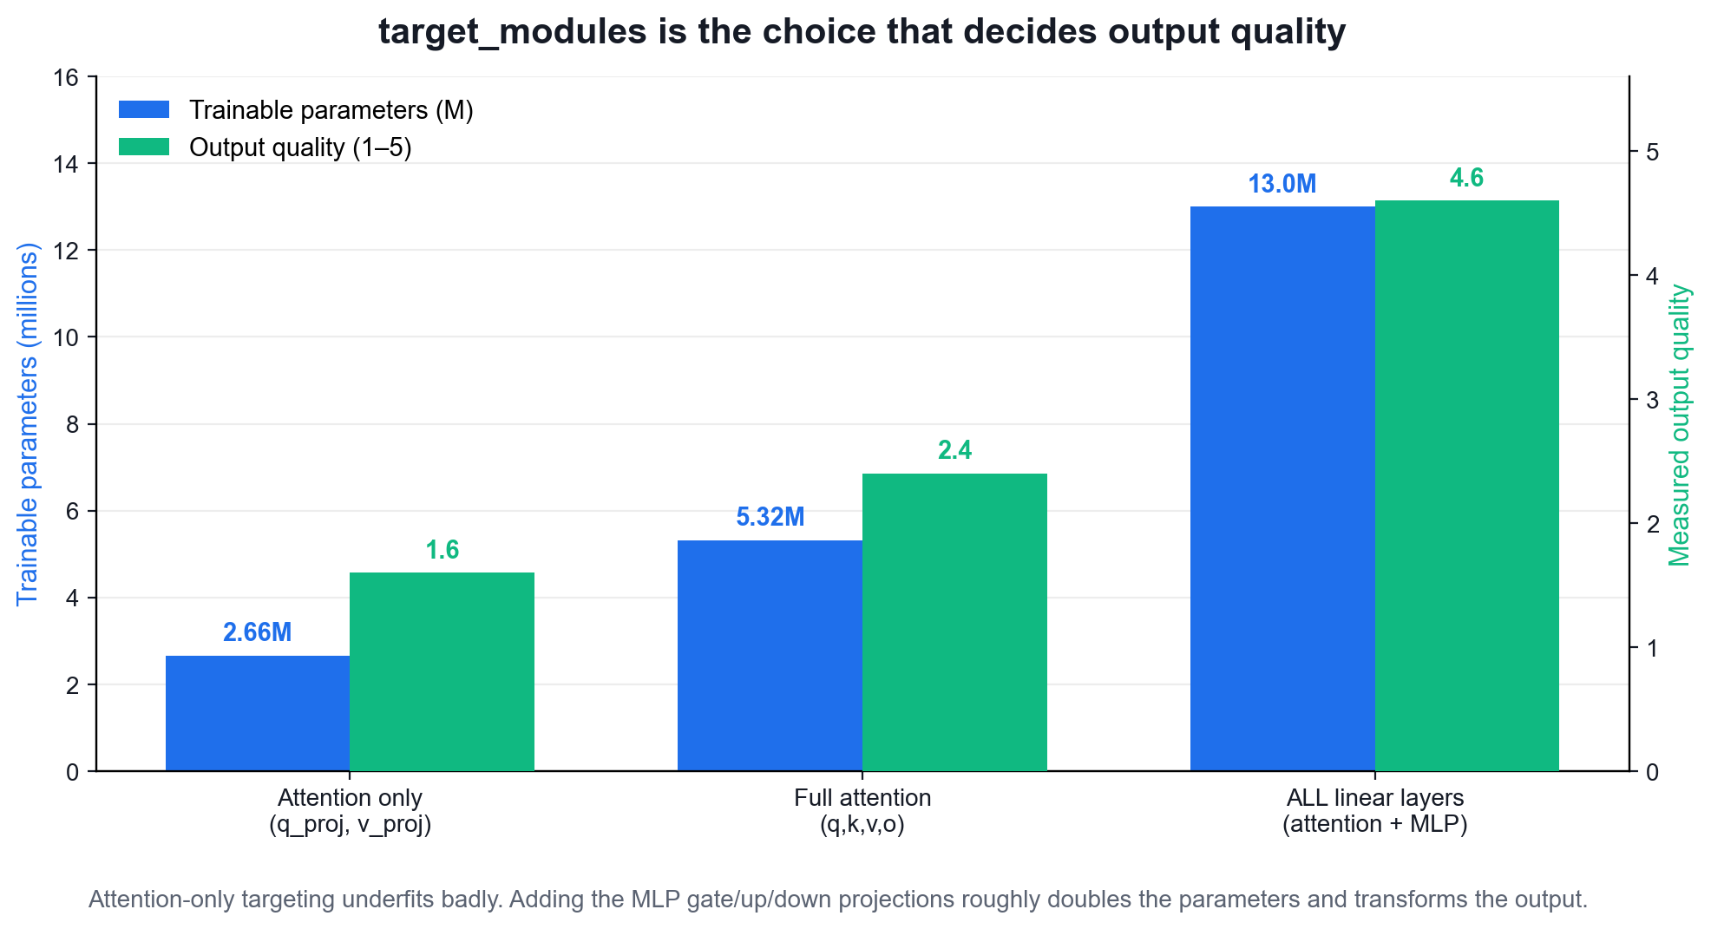
LO3 · THE FINDING THAT MATTERS MOST
target_modules Decides Output Quality
Targeting attention only (q_proj, v_proj) underfits badly. Adding the MLP gate/up/down projections is what produces usable output.
Fine Tuning Open Source LLM · C922
© 2026 Tertiary Infotech Academy Pte Ltd
23

Slide 24
LO3 · QLoRA
QLoRA: quantise the frozen weights, train in full precision.
The base model is stored in 4-bit NF4 and dequantised on the fly for each matmul, while the small adapter stays in bf16. Memory falls three to four times again; quality barely moves.
Fine Tuning Open Source LLM · C922
© 2026 Tertiary Infotech Academy Pte Ltd
24

Slide 25
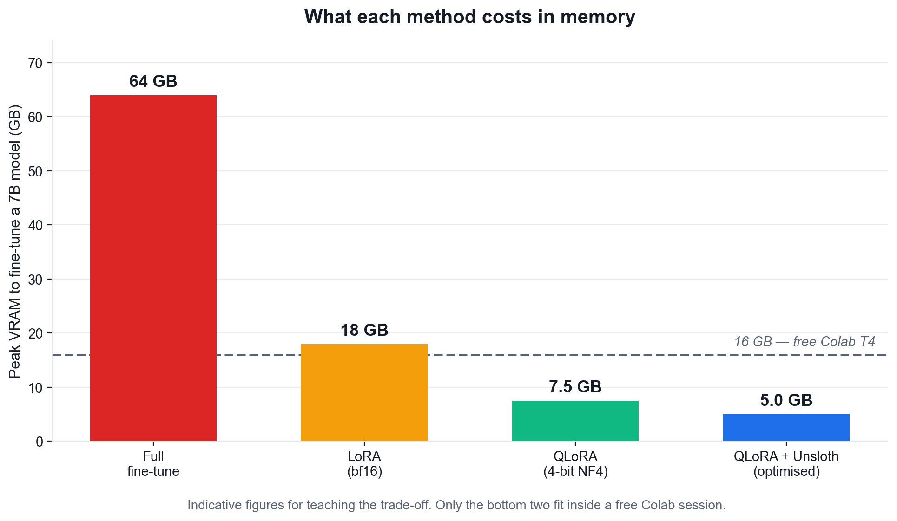
LO3 · THE MEMORY LADDER
What Each Method Costs in Memory
VRAM, not FLOPs, is the binding constraint. Only QLoRA fits a 7B fine-tune inside a free Colab session.
Fine Tuning Open Source LLM · C922
© 2026 Tertiary Infotech Academy Pte Ltd
25

Slide 26
LO3 · THE TRADE-OFF
LoRA vs QLoRA vs Full Fine Tuning
Dimension
Full fine tune
LoRA (bf16)
QLoRA (4-bit)
Trainable params
100%
< 1%
< 1%
Base weights
Updated
Frozen, bf16
Frozen, 4-bit NF4
VRAM (7B model)
~60+ GB
~16–20 GB
~6–8 GB
Quality
Baseline
≈ full
≈ LoRA
Catastrophic forgetting
High risk
Low
Low
Output artifact
Full model (GBs)
Adapter (MBs)
Adapter (MBs)
WHEN IT MATTERS LoRA often BEATS full fine tuning in practice, because freezing the base weights is itself a defence against catastrophic forgetting.
Fine Tuning Open Source LLM · C922
© 2026 Tertiary Infotech Academy Pte Ltd
26

Slide 27
LO3 · ACCELERATION
What Unsloth Adds
Hand-written Triton kernels
Attention, MLP and cross-entropy are re-implemented for the GPU rather than composed from PyTorch ops.
Manual backward pass
The gradients are derived by hand instead of being built by autograd, removing redundant work.
1
2
Roughly 2× faster
Same model, same data, same final loss — just less time on the GPU.
70–80% less VRAM
Its own gradient-checkpointing implementation offloads activations intelligently.
3
4
No accuracy loss
It is a kernel optimisation, not an approximation — the mathematics is unchanged.
Drop-in API
FastLanguageModel.from_pretrained and get_peft_model mirror the Transformers/PEFT calls.
5
6
Fine Tuning Open Source LLM · C922
© 2026 Tertiary Infotech Academy Pte Ltd
27

Slide 28
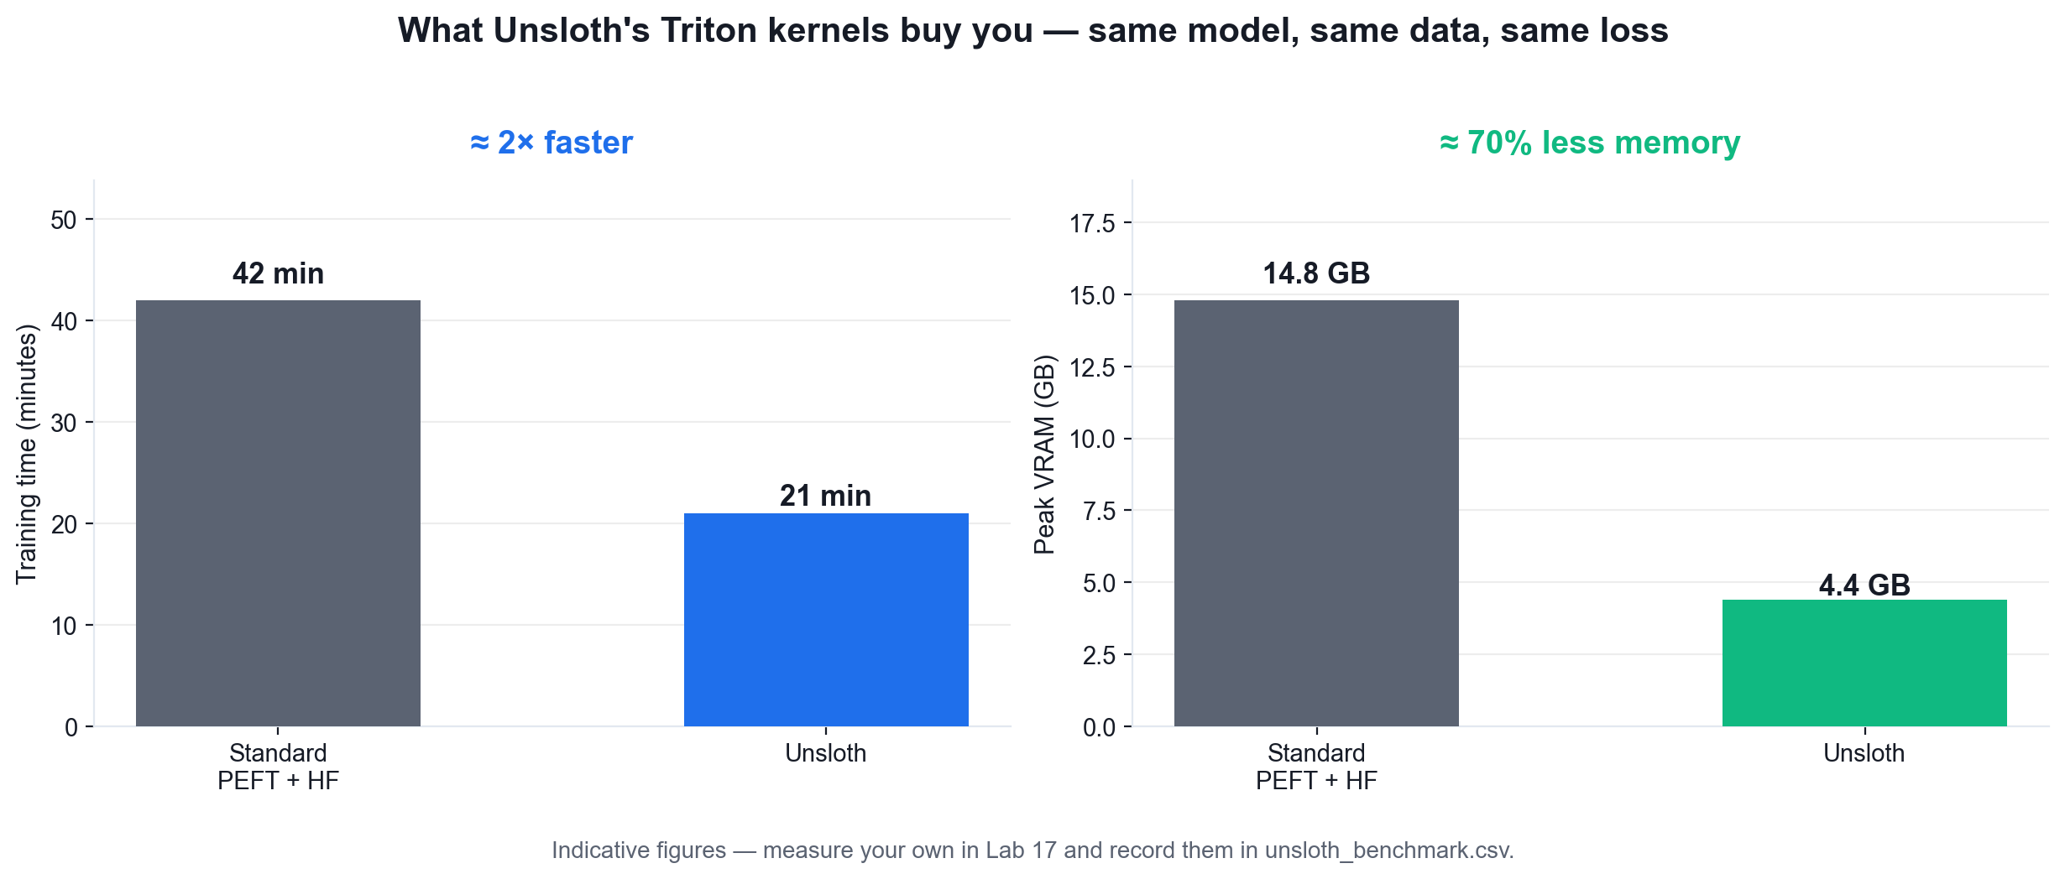
LO3 · MEASURED, NOT CLAIMED
What Unsloth's Kernels Buy You
You will measure these numbers yourself in Lab 17 and record them in unsloth_benchmark.csv.
Fine Tuning Open Source LLM · C922
© 2026 Tertiary Infotech Academy Pte Ltd
28

Slide 29
LO3 · THE REAL CONSTRAINT
Where the Memory Actually Goes
Component
Full fine-tune (7B)
LoRA (bf16)
QLoRA (4-bit)
Model weights
14 GB (bf16)
14 GB (frozen)
3.5 GB (NF4)
Gradients
14 GB
~0.05 GB (adapter only)
~0.05 GB
Optimizer state
28 GB (Adam: 2 moments)
~0.1 GB
~0.1 GB (8-bit)
Activations
4-8 GB
2-4 GB (checkpointing)
2-4 GB
Rough total
~60+ GB
~16-20 GB
~6-8 GB
WHEN IT MATTERS The optimizer state is the hidden cost: Adam keeps two moments per trainable parameter. Freezing the base weights removes it almost entirely — that is where LoRA's saving comes from.
Fine Tuning Open Source LLM · C922
© 2026 Tertiary Infotech Academy Pte Ltd
29

Slide 30
TERMS YOU WILL USE ALL DAY
The Vocabulary of Fine Tuning
Adapter
The small trainable module (A and B) added beside a frozen weight matrix.
Merging
Folding (α/r)·BA back into W to produce a single standalone model with zero added latency.
1
2
Quantisation
Storing weights at lower precision (4-bit NF4) and dequantising on the fly for compute.
Effective batch size
per_device_batch × gradient_accumulation × devices — what the optimiser actually sees.
3
4
Gradient checkpointing
Recomputing activations in the backward pass instead of storing them; trades time for VRAM.
Catastrophic forgetting
Losing general capability while gaining domain capability. Measure it; do not assume it.
5
6
Fine Tuning Open Source LLM · C922
© 2026 Tertiary Infotech Academy Pte Ltd
30

Slide 31
LO3 · IF YOU REMEMBER NOTHING ELSE
The Four Numbers That Decide a Fine-Tune
1
2
3
4
Learning rate
Epochs
Rank r
target_modules
2e-4 for LoRA
1-3, watch val loss
8-16 style, 32-64 skill
all linear layers
THE ORDER MATTERS
Tune the learning rate first — it dominates every other choice. Only then does it make sense to search over rank, alpha or batch size.
Fine Tuning Open Source LLM · C922
© 2026 Tertiary Infotech Academy Pte Ltd
31

Slide 32
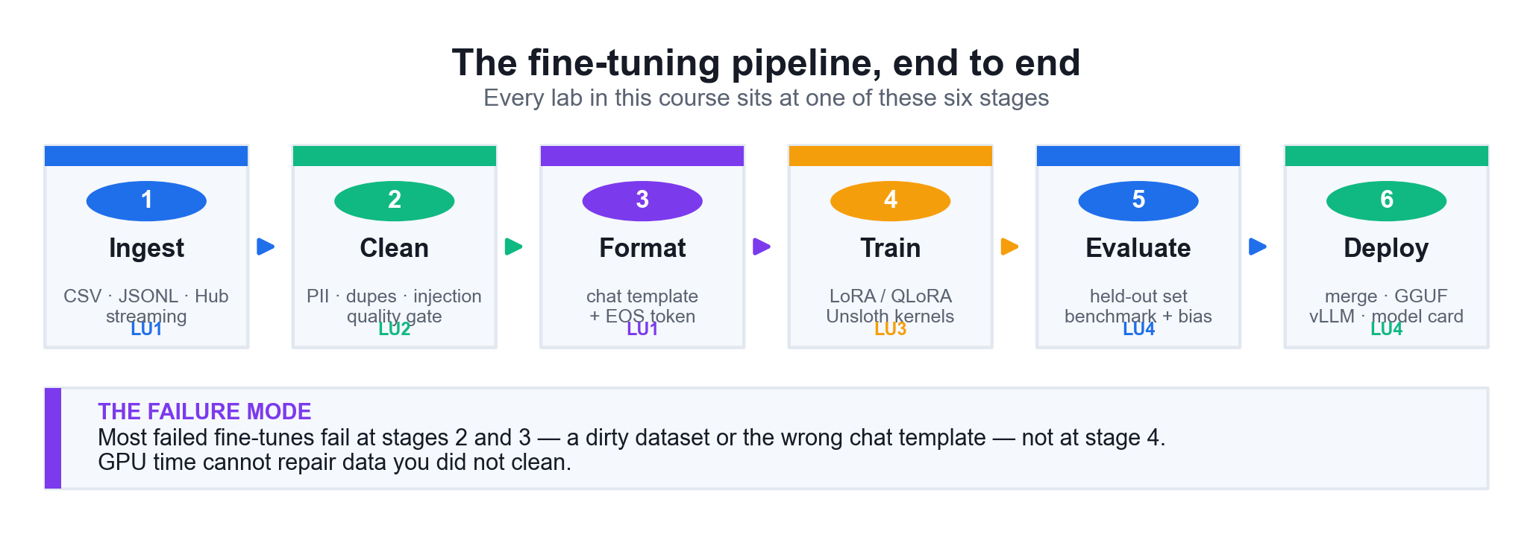
HOW THE COURSE FITS TOGETHER
The Fine-Tuning Pipeline, End to End
Every lab sits at one of these six stages. Most failed fine-tunes fail at stages 2 and 3 — not at stage 4.
Fine Tuning Open Source LLM · C922
© 2026 Tertiary Infotech Academy Pte Ltd
32

Slide 33
LESSON PLAN · TIME ALLOCATION
Where the Course Time Goes
WHAT THE DATA SHOWS
LU3 carries the largest weighting because LoRA, QLoRA and Unsloth are where the core practical skill sits — expect the most hands-on time there.
Fine Tuning Open Source LLM · C922
© 2026 Tertiary Infotech Academy Pte Ltd
33

Slide 34
01
LEARNING UNIT 01
Data Engineering
Data repositories for fine tuning · dataset ingestion · synthetic data generation · transformation into chat/instruction format
Fine Tuning Open Source LLM · C922
© 2026 Tertiary Infotech Academy Pte Ltd
34

Slide 35
LU1 · ORIENTATION
LU1 at a Glance
1
Learning outcome
Apply transformation methods to ingest and prepare synthetic data using cloud-based model tools.
2
Hands-on labs
Labs 1 and 5 in class · Labs 2–4 and 6 self-paced
3
Weighting
25% of course time · Morning
4
Topics
Create data repositories for fine tuning · Identify and implement a dataset ingestion solution · Identify and implement a data transformation solution
Fine Tuning Open Source LLM · C922
© 2026 Tertiary Infotech Academy Pte Ltd
35

Slide 36
LU1 · WEIGHTING 25%
Key Concepts — Data Engineering
1
A fine-tuning data repository is versioned, immutable and reproducible — the Hugging Face Hub, an S3/GCS bucket or a local `datasets` cache all serve this role, and every training run must be traceable to an exact dataset revision.
2
Synthetic data generation creates training examples where real data is scarce, sensitive or expensive — self-instruct bootstrapping, teacher-model distillation, template expansion and programmatic augmentation are the four families you will use.
3
Synthetic data must preserve the statistical properties of the real distribution: match the label balance, the length distribution and the domain vocabulary, then de-duplicate against the real set so you do not train on near-copies.
4
Generative architectures differ in what they model: conditional GANs learn a generator/discriminator game, diffusion models learn to reverse a noising process, and autoregressive transformers factorise the sequence probability token by token.
Fine Tuning Open Source LLM · C922
© 2026 Tertiary Infotech Academy Pte Ltd
36

Slide 37
LU1 · WEIGHTING 25%
Key Concepts — Data Engineering (2)
1
Hardware acceleration: GPUs give general-purpose massively-parallel matrix maths with large VRAM; TPUs are systolic-array ASICs tuned for dense matmul at scale. VRAM, not FLOPs, is the binding constraint for fine tuning.
2
Cloud training platforms — Colab, Kaggle, AWS SageMaker, Vertex AI and Azure ML — supply elastic accelerators, managed storage and experiment tracking so a fine-tune is reproducible.
3
The `datasets` library streams, shards, maps and caches datasets far larger than RAM; `load_dataset`, `.map()`, `.filter()` and `.train_test_split()` are the four verbs you need.
4
Transformation converts raw records into the exact chat/instruction template the base model expects — a mismatched template is the single most common cause of a failed fine-tune.
Fine Tuning Open Source LLM · C922
© 2026 Tertiary Infotech Academy Pte Ltd
37

Slide 38
LU1 · WEIGHTING 25%
Key Concepts — Data Engineering (3)
The Alpaca instruction template (instruction / input / response) and the ChatML role template (system / user / assistant) are the two dominant formats; `tokenizer.apply_chat_template()` renders the model's own correct form.
1
Every training example must end with the EOS token, or the fine-tuned model will never learn to stop generating.
2
Fine Tuning Open Source LLM · C922
© 2026 Tertiary Infotech Academy Pte Ltd
38

Slide 39
LU1 · THE DATA PATH
From Raw Records to a Training File
1
2
3
4
5
Ingest
Normalise
Split
Template
Version
CSV · JSONL · Hub
one schema
seeded 80/10/10
chat + EOS
hash + card
THE POINT
A fine-tuning dataset is not a folder of files — it is a versioned, hashed, reproducible artifact that a training run can be traced back to.
Fine Tuning Open Source LLM · C922
© 2026 Tertiary Infotech Academy Pte Ltd
39

Slide 40
LU1 · SYNTHETIC DATA GENERATION
Four Ways to Make Synthetic Data
Method
How it works
Diversity
Cost
Watch out for
Template expansion
Fill slots in a grammar
Low
Free
Repetitive phrasing
Self-instruct
Teacher model writes new items
High
Inference cost
Teacher's own biases
Back-translation
Translate out and back
Medium
Low
Meaning drift
Programmatic augment
Perturb real examples
Low–medium
Free
Near-duplicates of the seed
WHEN IT MATTERS Whatever the method, prove it statistically: match the length distribution, the label balance and the vocabulary, then de-duplicate against the real set.
Fine Tuning Open Source LLM · C922
© 2026 Tertiary Infotech Academy Pte Ltd
40

Slide 41
LU1 · DATA TRANSFORMATION
The Chat Template Is Not Optional
The single most common cause of a fine-tune that trains cleanly but behaves badly.
# WRONG — a template the base model never saw
text = f'Q: {question}\nA: {answer}'
# RIGHT — the model's OWN template
text = tokenizer.apply_chat_template(
[{'role':'user', 'content': question},
{'role':'assistant', 'content': answer}],
tokenize=False,
)
# ALWAYS append EOS, or it never learns to stop
text = text + tokenizer.eos_token
apply_chat_template
Emits the exact special tokens the base model was pre-trained with.
Why it matters
A mismatched template means the model must re-learn the format from scratch.
The EOS token
Without it the model generates until it hits max_new_tokens, every time.
Verify it
Decode with skip_special_tokens=False and LOOK at the tokens.
Fine Tuning Open Source LLM · C922
© 2026 Tertiary Infotech Academy Pte Ltd
41

Slide 42
LU1 · ARCHITECTURES
Generative Architectures Compared
Family
Generation quality
Training stability
Compute
Typical use
Conditional GAN
Sharp, can mode-collapse
Low — adversarial game
Low
Fast image synthesis
Diffusion
Highest fidelity + diversity
High — simple MSE loss
Very high
Text-to-image, audio
Autoregressive
State of the art for text
High — cross-entropy
High
LLMs, code, multi-modal
WHEN IT MATTERS Diffusion trains stably because its objective is a plain MSE on the added noise — there is no adversarial game to balance.
Fine Tuning Open Source LLM · C922
© 2026 Tertiary Infotech Academy Pte Ltd
42

Slide 43
LU1 · HARDWARE AND PLATFORMS
Accelerators and Cloud Platforms
NVIDIA T4 (16 GB)
Free on Colab. Enough for QLoRA on 1B–8B models — the environment for this course.
NVIDIA A100 / H100
40–80 GB. Full fine-tuning up to 7B, or large-scale LoRA training.
1
2
Google TPU
Systolic-array ASIC, excellent at large dense matmul, but needs XLA-compatible code.
AWS SageMaker
Managed training jobs, experiment tracking, S3 storage — production pipelines.
3
4
Google Vertex AI
Managed training with GPU or TPU, plus model registry and endpoints.
Azure ML
Managed compute and MLOps for Microsoft estates.
5
6
Fine Tuning Open Source LLM · C922
© 2026 Tertiary Infotech Academy Pte Ltd
43

Slide 44
WHAT YOU'LL DO
Hands-On Labs — Data Engineering
Labs 1–2
Labs 3–4
Labs 5–6
• Set Up the Fine-Tuning Environment on Colab
• Create a Versioned Data Repository for Fine Tuning
• Generate Synthetic Training Data
• Ingest Datasets from Multiple Sources
• Transform Data into Chat and Instruction Formats
• Compare Generative Architectures and Accelerator Options
Fine Tuning Open Source LLM · C922
© 2026 Tertiary Infotech Academy Pte Ltd
44

Slide 45
LU1 · HANDS-ON · IN CLASS
Set Up the Fine-Tuning Environment on Colab
LAB 1
Prepare a reproducible GPU environment and verify the accelerator, VRAM and library stack
Open a free Colab GPU runtime, install the Unsloth + PEFT + TRL stack, and verify the GPU, the available VRAM and every library version. You then record the environment in a reproducibility manifest so the same run can be repeated later.
YOU'LL BUILD
TOOLCHAIN
DONE WHEN
A verified GPU notebook environment and an env_manifest.json recording the GPU model, VRAM, CUDA version and the exact version of every library used in the course.
Google Colab, NVIDIA T4, PyTorch, Unsloth, PEFT, TRL, bitsandbytes
nvidia-smi shows a T4 (or better), torch.cuda.is_available() is True, env_manifest.json exists with all seven library versions filled in, and the test model loads and unloads without an out-of-memory error.
Fine Tuning Open Source LLM · C922
© 2026 Tertiary Infotech Academy Pte Ltd
45

Slide 46
LAB 1 · THE SHAPE OF IT
How Lab 1 Runs
1
2
3
4
5
Open a Colab GPU runtime
Confirm the GPU is attached
Install the fine-tuning stack
Verify PyTorch sees the GPU
Record every library version
Google Colab · T4
nvidia-smi
unsloth · peft · trl
torch.cuda
env_manifest.json
THE POINT
Prepare a reproducible GPU environment and verify the accelerator, VRAM and library stack
Fine Tuning Open Source LLM · C922
© 2026 Tertiary Infotech Academy Pte Ltd
46

Slide 47
LAB 1 · VERIFY
Set Up the Fine-Tuning Environment on Colab
✅ Expected result
nvidia-smi shows a T4 (or better), torch.cuda.is_available() is True, env_manifest.json exists with all seven library versions filled in, and the test model loads and unloads without an out-of-memory error.
IF IT DOESN'T WORK
CUDA out of memory
No GPU attached
ModuleNotFoundError
Restart the runtime, lower per_device_train_batch_size, raise gradient_accumulation_steps.
Runtime > Change runtime type > T4 GPU, then re-run from the first cell.
Re-run the pip install cell; on Colab, restart the session after installing unsloth.
Fine Tuning Open Source LLM · C922
© 2026 Tertiary Infotech Academy Pte Ltd
47

Slide 48
LU1 · HANDS-ON · SELF-PACED
Create a Versioned Data Repository for Fine Tuning
LAB 2
Build an immutable, versioned, reproducible data repository for a fine-tuning corpus
Take a raw customer-support export and turn it into a proper fine-tuning data repository: a content-hashed, versioned, split dataset with a dataset card, so any future training run can be traced back to the exact bytes it was trained on.
YOU'LL BUILD
TOOLCHAIN
DONE WHEN
A versioned dataset repository at data_repo/v1/ containing train/validation/test splits, a manifest.json with a SHA-256 content hash and row counts, and a DATASET_CARD.md.
Hugging Face datasets, pandas, hashlib, JSON Lines
data_repo/v1/ contains three JSONL splits whose row counts sum to the number of usable records, manifest.json records a SHA-256 for each split, DATASET_CARD.md exists, and load_dataset() returns a DatasetDict with all three splits.
Fine Tuning Open Source LLM · C922
© 2026 Tertiary Infotech Academy Pte Ltd
48

Slide 49
LAB 2 · THE SHAPE OF IT
How Lab 2 Runs
1
2
3
4
5
Load the raw ticket export
Normalise to one schema
Split with a fixed seed
Write JSON Lines splits
Content-hash and card it
pandas · CSV
instruction/input/output
scikit-learn · seed 3407
train/val/test.jsonl
SHA-256 · DATASET_CARD
THE POINT
Build an immutable, versioned, reproducible data repository for a fine-tuning corpus
Fine Tuning Open Source LLM · C922
© 2026 Tertiary Infotech Academy Pte Ltd
49

Slide 50
LAB 2 · VERIFY
Create a Versioned Data Repository for Fine Tuning
✅ Expected result
data_repo/v1/ contains three JSONL splits whose row counts sum to the number of usable records, manifest.json records a SHA-256 for each split, DATASET_CARD.md exists, and load_dataset() returns a DatasetDict with all three splits.
IF IT DOESN'T WORK
CUDA out of memory
No GPU attached
ModuleNotFoundError
Restart the runtime, lower per_device_train_batch_size, raise gradient_accumulation_steps.
Runtime > Change runtime type > T4 GPU, then re-run from the first cell.
Re-run the pip install cell; on Colab, restart the session after installing unsloth.
Fine Tuning Open Source LLM · C922
© 2026 Tertiary Infotech Academy Pte Ltd
50

Slide 51
LU1 · HANDS-ON · SELF-PACED
Generate Synthetic Training Data
LAB 3
Generate synthetic fine-tuning examples that preserve the statistical properties of real data
Real data is scarce and privacy-restricted, so you generate synthetic examples using three different methods — template expansion, self-instruct bootstrapping and programmatic augmentation — then prove statistically that the synthetic set matches the real distribution.
YOU'LL BUILD
TOOLCHAIN
DONE WHEN
A synthetic dataset of several hundred examples produced by three methods, plus a distribution comparison report showing length, label-balance and vocabulary overlap against the real seed set.
Hugging Face datasets, pandas, numpy, scipy, matplotlib
synthetic_examples.jsonl contains several hundred de-duplicated examples produced by all three methods, the KS test p-value is reported, vocabulary overlap is between roughly 40% and 95%, and synthetic_distribution.png shows the two length histograms overlapping.
Fine Tuning Open Source LLM · C922
© 2026 Tertiary Infotech Academy Pte Ltd
51

Slide 52
LAB 3 · THE SHAPE OF IT
How Lab 3 Runs
1
2
3
4
5
Load the real seed set
Expand from templates
Bootstrap with self-instruct
Augment real examples
Prove the distributions match
seed_examples.jsonl
grammar + slots
Unsloth teacher model
controlled perturbation
scipy KS test
THE POINT
Generate synthetic fine-tuning examples that preserve the statistical properties of real data
Fine Tuning Open Source LLM · C922
© 2026 Tertiary Infotech Academy Pte Ltd
52

Slide 53
LAB 3 · VERIFY
Generate Synthetic Training Data
✅ Expected result
synthetic_examples.jsonl contains several hundred de-duplicated examples produced by all three methods, the KS test p-value is reported, vocabulary overlap is between roughly 40% and 95%, and synthetic_distribution.png shows the two length histograms overlapping.
IF IT DOESN'T WORK
CUDA out of memory
No GPU attached
ModuleNotFoundError
Restart the runtime, lower per_device_train_batch_size, raise gradient_accumulation_steps.
Runtime > Change runtime type > T4 GPU, then re-run from the first cell.
Re-run the pip install cell; on Colab, restart the session after installing unsloth.
Fine Tuning Open Source LLM · C922
© 2026 Tertiary Infotech Academy Pte Ltd
53

Slide 54
LU1 · HANDS-ON · SELF-PACED
Ingest Datasets from Multiple Sources
LAB 4
Implement a dataset ingestion solution that loads, streams and merges heterogeneous sources
Build the ingestion layer of a fine-tuning pipeline: load from CSV, JSONL and the Hugging Face Hub, stream a dataset too large for RAM, normalise every source to one schema, and concatenate them into a single training corpus with provenance retained.
YOU'LL BUILD
TOOLCHAIN
DONE WHEN
A single unified DatasetDict assembled from four differently-shaped sources, each row tagged with its provenance, plus a streaming ingestion demonstration that never loads the full dataset.
Hugging Face datasets, pandas, JSON Lines, streaming IterableDataset
The merged corpus has exactly the four canonical columns, Counter(corpus['source']) shows rows from all three batch sources, the streaming demo prints three rows without a full download, and ingested_train.jsonl / ingested_test.jsonl are written.
Fine Tuning Open Source LLM · C922
© 2026 Tertiary Infotech Academy Pte Ltd
54

Slide 55
LAB 4 · THE SHAPE OF IT
How Lab 4 Runs
1
2
3
4
5
Load a local CSV source
Load a JSON Lines source
Slice a Hub dataset
Stream a large corpus
Normalise and concatenate
datasets · CSV
datasets · JSONL
Hugging Face Hub
streaming=True
concatenate_datasets
THE POINT
Implement a dataset ingestion solution that loads, streams and merges heterogeneous sources
Fine Tuning Open Source LLM · C922
© 2026 Tertiary Infotech Academy Pte Ltd
55

Slide 56
LAB 4 · VERIFY
Ingest Datasets from Multiple Sources
✅ Expected result
The merged corpus has exactly the four canonical columns, Counter(corpus['source']) shows rows from all three batch sources, the streaming demo prints three rows without a full download, and ingested_train.jsonl / ingested_test.jsonl are written.
IF IT DOESN'T WORK
CUDA out of memory
No GPU attached
ModuleNotFoundError
Restart the runtime, lower per_device_train_batch_size, raise gradient_accumulation_steps.
Runtime > Change runtime type > T4 GPU, then re-run from the first cell.
Re-run the pip install cell; on Colab, restart the session after installing unsloth.
Fine Tuning Open Source LLM · C922
© 2026 Tertiary Infotech Academy Pte Ltd
56

Slide 57
LU1 · HANDS-ON · IN CLASS
Transform Data into Chat and Instruction Formats
LAB 5
Apply data transformation techniques that convert raw records into the model's training format
Convert the ingested corpus into the exact text the model must see during training. You render the Alpaca template by hand, render the model's native chat template with apply_chat_template(), append the EOS token, and prove why a template mismatch silently ruins a fine-tune.
YOU'LL BUILD
TOOLCHAIN
DONE WHEN
A formatted training dataset whose 'text' column is exactly what the trainer will tokenise, verified against the model's own chat template and confirmed to terminate with the EOS token.
Hugging Face datasets, transformers tokenizer, Unsloth chat templates
formatted_train.jsonl exists with a 'text' column; printing one row shows the Llama 3 header tokens; the token-length percentile table is produced; and no remaining example exceeds MAX_LEN tokens.
Fine Tuning Open Source LLM · C922
© 2026 Tertiary Infotech Academy Pte Ltd
57

Slide 58
LAB 5 · THE SHAPE OF IT
How Lab 5 Runs
1
2
3
4
5
Load the ingested corpus
Render the Alpaca template
Render the native chat template
Append the EOS token
Compare the two renderings
ingested_train.jsonl
instruction format
apply_chat_template
tokenizer.eos_token
token ID inspection
THE POINT
Apply data transformation techniques that convert raw records into the model's training format
Fine Tuning Open Source LLM · C922
© 2026 Tertiary Infotech Academy Pte Ltd
58

Slide 59
LAB 5 · VERIFY
Transform Data into Chat and Instruction Formats
✅ Expected result
formatted_train.jsonl exists with a 'text' column; printing one row shows the Llama 3 header tokens; the token-length percentile table is produced; and no remaining example exceeds MAX_LEN tokens.
IF IT DOESN'T WORK
CUDA out of memory
No GPU attached
ModuleNotFoundError
Restart the runtime, lower per_device_train_batch_size, raise gradient_accumulation_steps.
Runtime > Change runtime type > T4 GPU, then re-run from the first cell.
Re-run the pip install cell; on Colab, restart the session after installing unsloth.
Fine Tuning Open Source LLM · C922
© 2026 Tertiary Infotech Academy Pte Ltd
59

Slide 60
LU1 · HANDS-ON · SELF-PACED
Compare Generative Architectures and Accelerator Options
LAB 6
Compare GAN, diffusion and autoregressive architectures and select accelerator and cloud platform
Run a hands-on comparison of the three generative architecture families on the same small task, then measure the real memory and throughput cost of a fine-tune on the available accelerator so you can justify a hardware and cloud-platform choice with numbers rather than opinion.
YOU'LL BUILD
TOOLCHAIN
DONE WHEN
A comparison table of the three architecture families on generation quality, training stability and compute cost, plus measured throughput and VRAM figures for the lab GPU.
PyTorch, Unsloth, diffusers, matplotlib, nvidia-smi
architecture_comparison.csv and platform_comparison.csv are written, the autoregressive throughput is reported in tokens/second, the diffusion step-count timings show latency rising with steps, and peak VRAM is reported for both model types.
Fine Tuning Open Source LLM · C922
© 2026 Tertiary Infotech Academy Pte Ltd
60

Slide 61
LAB 6 · THE SHAPE OF IT
How Lab 6 Runs
1
2
3
4
5
Time an autoregressive model
Time a diffusion model
Time a conditional GAN
Measure peak VRAM each way
Build the comparison table
Unsloth · Llama 3.2
diffusers · tiny-sd
PyTorch generator
torch.cuda memory
architecture table CSV
THE POINT
Compare GAN, diffusion and autoregressive architectures and select accelerator and cloud platform
Fine Tuning Open Source LLM · C922
© 2026 Tertiary Infotech Academy Pte Ltd
61

Slide 62
LAB 6 · VERIFY
Compare Generative Architectures and Accelerator Options
✅ Expected result
architecture_comparison.csv and platform_comparison.csv are written, the autoregressive throughput is reported in tokens/second, the diffusion step-count timings show latency rising with steps, and peak VRAM is reported for both model types.
IF IT DOESN'T WORK
CUDA out of memory
No GPU attached
ModuleNotFoundError
Restart the runtime, lower per_device_train_batch_size, raise gradient_accumulation_steps.
Runtime > Change runtime type > T4 GPU, then re-run from the first cell.
Re-run the pip install cell; on Colab, restart the session after installing unsloth.
Fine Tuning Open Source LLM · C922
© 2026 Tertiary Infotech Academy Pte Ltd
62

Slide 63
LU1 · WHAT YOU CAN NOW DO
Recap — Data Engineering
Lab 1
Prepare a reproducible GPU environment and verify the accelerator, VRAM and library stack
Lab 2
Build an immutable, versioned, reproducible data repository for a fine-tuning corpus
1
2
Lab 3
Generate synthetic fine-tuning examples that preserve the statistical properties of real data
Lab 4
Implement a dataset ingestion solution that loads, streams and merges heterogeneous sources
3
4
Lab 5
Apply data transformation techniques that convert raw records into the model's training format
Lab 6
Compare GAN, diffusion and autoregressive architectures and select accelerator and cloud platform
5
6
Fine Tuning Open Source LLM · C922
© 2026 Tertiary Infotech Academy Pte Ltd
63

Slide 64
LU1 · WHAT GOES WRONG
Common Mistakes — Data Engineering
Training on the wrong template
The single biggest cause of a fine-tune that trains cleanly and behaves badly. Always use tokenizer.apply_chat_template().
Forgetting the EOS token
The model never learns where an answer ends and generates until it hits the token limit.
1
2
An unseeded split
An unseeded train/test split cannot be reproduced, which silently invalidates every later comparison.
Synthetic data that is a paraphrase
If it merely restates the seed set it adds no coverage — de-duplicate against the real data.
3
4
No provenance on merged sources
When quality drops you cannot tell which source caused it.
Ignoring the token-length distribution
Truncated examples teach the model to produce unfinished answers.
5
6
Fine Tuning Open Source LLM · C922
© 2026 Tertiary Infotech Academy Pte Ltd
64

Slide 65
02
LEARNING UNIT 02
Exploratory Data Analysis
Cleaning and sanitisation · optimisation strategies for higher-quality outputs · feature engineering · ETL pipelines · analysis and visualisation
Fine Tuning Open Source LLM · C922
© 2026 Tertiary Infotech Academy Pte Ltd
65

Slide 66
LU2 · ORIENTATION
LU2 at a Glance
1
Learning outcome
Develop optimized data pipelines for feature engineering using various optimization strategies.
2
Hands-on labs
Lab 7 in class · Labs 8–12 self-paced
3
Weighting
25% of course time · Late morning
4
Topics
Sanitize and prepare data for modelling · Perform feature engineering for fine tuning · Analyze and visualize data for fine tuning insights
Fine Tuning Open Source LLM · C922
© 2026 Tertiary Infotech Academy Pte Ltd
66

Slide 67
LU2 · WEIGHTING 25%
Key Concepts — Exploratory Data Analysis
1
Garbage in, garbage out is literal for fine tuning: a 1,000-example clean dataset routinely beats a 100,000-example dirty one, because LoRA has few parameters and will faithfully learn whatever noise you show it.
2
Sanitisation removes PII, exact and near duplicates, truncated records, prompt-injection payloads and toxic content — each of which becomes a learned behaviour if left in.
3
MinHash/LSH near-duplicate detection catches the paraphrased copies that exact hashing misses, and must also be run across the train/test boundary to prevent evaluation leakage.
4
Optimisation strategies for higher-quality outputs: curate for quality over quantity, balance the task mix, tune decoding parameters, apply preference optimisation (DPO), and iterate with error analysis rather than blindly adding data.
Fine Tuning Open Source LLM · C922
© 2026 Tertiary Infotech Academy Pte Ltd
67

Slide 68
LU2 · WEIGHTING 25%
Key Concepts — Exploratory Data Analysis (2)
1
Decoding parameters — temperature, top-p, top-k, repetition penalty and max_new_tokens — change output quality at inference with zero training cost, and must be held fixed when comparing models.
2
Feature engineering for LLM fine tuning is prompt-side engineering: system-prompt design, few-shot exemplar selection, field concatenation order, length bucketing and difficulty tagging.
3
Feature selection here means example selection — perplexity filtering, embedding-diversity sampling and quality scoring keep the highest-signal subset of a large candidate pool.
4
Data augmentation for generative models: paraphrase generation, back-translation, instruction rewriting, and response re-ranking expand a small seed set without new human labelling.
Fine Tuning Open Source LLM · C922
© 2026 Tertiary Infotech Academy Pte Ltd
68

Slide 69
LU2 · WEIGHTING 25%
Key Concepts — Exploratory Data Analysis (3)
1
An ETL pipeline for a fine-tuning dataset is Extract (load raw sources) → Transform (clean, dedupe, template, tokenise) → Load (push a versioned, split dataset), with a validation gate between each stage.
2
Generative concepts: transfer learning reuses pre-trained representations, knowledge distillation trains a small student from a large teacher, self-supervised learning creates labels from the data itself, and explainability makes the resulting behaviour inspectable.
3
Token-length analysis drives the `max_seq_length` choice: set it at roughly the 95th–99th percentile so you neither truncate real content nor pay quadratic attention cost for padding.
4
Visualising label balance, length distribution and embedding clusters (UMAP/t-SNE) exposes the gaps and redundancies in a dataset before you spend GPU hours on it.
Fine Tuning Open Source LLM · C922
© 2026 Tertiary Infotech Academy Pte Ltd
69

Slide 70
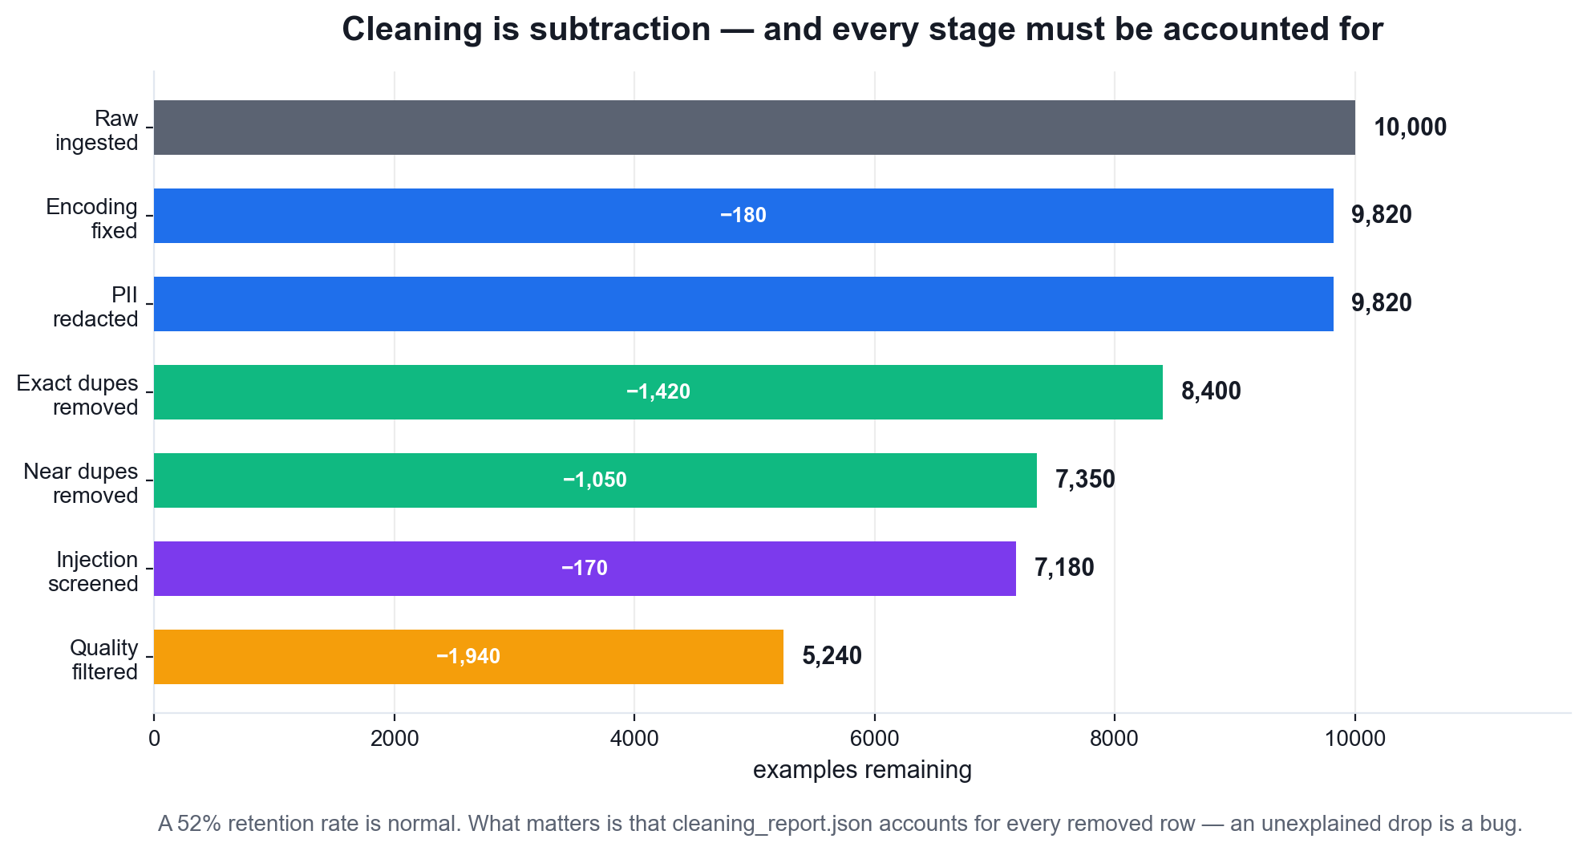
LU2 · DATA QUALITY
Cleaning Is Subtraction
A 50% retention rate is normal. What matters is that every removed row is accounted for — an unexplained drop is a bug, not a cleaning success.
Fine Tuning Open Source LLM · C922
© 2026 Tertiary Infotech Academy Pte Ltd
70

Slide 71
LU2 · THE SANITISATION GAUNTLET
What Must Come Out of a Training Set
PII
Emails, phones, NRIC/FIN, card numbers — a fine-tuned model memorises and regurgitates them.
Exact duplicates
Implicit over-weighting: the model sees them more often and over-fits to them.
1
2
Near duplicates
Paraphrased copies survive exact hashing and leak evaluation data into training.
Truncated records
Teach the model to produce unfinished answers.
3
4
Prompt injection
A poisoned example teaches the model to obey the injection — a supply-chain attack.
Encoding damage
Mojibake becomes learned garbage tokens.
5
6
Fine Tuning Open Source LLM · C922
© 2026 Tertiary Infotech Academy Pte Ltd
71

Slide 72
LU2 · QUALITY OVER QUANTITY
A thousand clean examples beat a hundred thousand dirty ones.
LoRA has very few parameters, so it learns whatever you show it with high fidelity — including the noise. Curation is not preparation for the real work; it IS the work.
Fine Tuning Open Source LLM · C922
© 2026 Tertiary Infotech Academy Pte Ltd
72

Slide 73
LU2 · PROMPT-SIDE FEATURES
Feature Engineering for Fine Tuning
System prompt design
The highest-leverage single feature: fixes role, tone and refusal behaviour across every example.
Few-shot exemplar selection
Attach the nearest neighbours as in-context examples to teach the format faster.
1
2
Field ordering
Instruction, then context, then input — a consistent order the model can rely on.
Length bucketing
Group similar lengths into a batch to cut padding waste — free throughput.
3
4
Difficulty tagging
Control the curriculum mix, and diagnose which band the model fails on.
Example selection
Perplexity filtering and embedding diversity keep the highest-signal subset.
5
6
Fine Tuning Open Source LLM · C922
© 2026 Tertiary Infotech Academy Pte Ltd
73

Slide 74
LU2 · PIPELINE ARCHITECTURE
The ETL Pipeline for a Fine-Tuning Dataset
1
2
3
4
5
Extract
Transform
Quality gate
Load
Report
load raw sources
clean · dedupe · template
raise, don't ship
versioned + hashed
per-stage counts
WHAT MAKES IT A PIPELINE
The quality gate. A script transforms data; a pipeline refuses to ship data that violates its declared contract.
Fine Tuning Open Source LLM · C922
© 2026 Tertiary Infotech Academy Pte Ltd
74

Slide 75
LU2 · FOUNDATIONS
Generative Concepts You Must Explain
Transfer learning
Pre-trained representations are reused; fine tuning adapts rather than teaching from scratch.
Knowledge distillation
A large teacher supplies soft targets that transfer capability to a smaller student.
1
2
Self-supervised learning
Labels come from the data itself — next-token prediction created the base model.
Explainability
Making the resulting behaviour inspectable: attribution, probing, ablation.
3
4
Fine Tuning Open Source LLM · C922
© 2026 Tertiary Infotech Academy Pte Ltd
75

Slide 76
LU2 · OPTIMISING WITHOUT TRAINING
Decoding Parameters — Free Quality
Parameter
What it does
Low value
High value
Use it for
temperature
Rescales logits before sampling
Focused, repeatable
Creative, incoherent
Tone of output
top_p
Samples from the top probability mass
Conservative
Full distribution
Adaptive diversity
top_k
Restricts to the k likeliest tokens
Very narrow
Little effect
Hard cap on candidates
repetition_penalty
Penalises already-used tokens
Loops appear
Unnatural phrasing
Killing 4-gram loops
WHEN IT MATTERS Use GREEDY decoding for every evaluation so results are reproducible, and sampling only for user-facing text. Never compare two models under different decoders.
Fine Tuning Open Source LLM · C922
© 2026 Tertiary Infotech Academy Pte Ltd
76

Slide 77
WHAT YOU'LL DO
Hands-On Labs — Exploratory Data Analysis
Labs 7–8
Labs 9–10
Labs 11–12
• Clean and Sanitize a Fine-Tuning Dataset
• Feature Engineering for Fine Tuning
• Build an ETL Pipeline for Fine-Tuning Datasets
• Analyse and Visualise a Fine-Tuning Dataset
• Tune Decoding Parameters for Higher-Quality Output
• Transfer Learning, Distillation and Self-Supervised Learning
Fine Tuning Open Source LLM · C922
© 2026 Tertiary Infotech Academy Pte Ltd
77

Slide 78
LU2 · HANDS-ON · IN CLASS
Clean and Sanitize a Fine-Tuning Dataset
LAB 7
Clean, sanitize and prepare a raw corpus so the fine-tune learns signal rather than noise
Take a deliberately dirty corpus and run the full sanitisation gauntlet — PII redaction, exact and near-duplicate removal, truncation and encoding repair, prompt-injection screening and quality scoring — measuring how many rows each stage removes and why.
YOU'LL BUILD
TOOLCHAIN
DONE WHEN
A cleaned dataset plus a cleaning report that records, stage by stage, how many rows were removed and for what reason — the audit trail a data pipeline must produce.
pandas, regex, datasketch MinHash/LSH, ftfy, Hugging Face datasets
cleaned_corpus.jsonl exists, cleaning_report.json accounts for every removed row by stage, no email/phone/NRIC pattern survives a re-scan of the cleaned file, and retention_pct is reported.
Fine Tuning Open Source LLM · C922
© 2026 Tertiary Infotech Academy Pte Ltd
78

Slide 79
LAB 7 · THE SHAPE OF IT
How Lab 7 Runs
1
2
3
4
5
Profile the dirty corpus
Repair encoding damage
Redact every PII pattern
Remove near duplicates
Screen for prompt injection
dirty_corpus.jsonl
ftfy · NFKC
regex · email/phone/NRIC
datasketch MinHash
injection patterns
THE POINT
Clean, sanitize and prepare a raw corpus so the fine-tune learns signal rather than noise
Fine Tuning Open Source LLM · C922
© 2026 Tertiary Infotech Academy Pte Ltd
79

Slide 80
LAB 7 · VERIFY
Clean and Sanitize a Fine-Tuning Dataset
✅ Expected result
cleaned_corpus.jsonl exists, cleaning_report.json accounts for every removed row by stage, no email/phone/NRIC pattern survives a re-scan of the cleaned file, and retention_pct is reported.
IF IT DOESN'T WORK
CUDA out of memory
No GPU attached
ModuleNotFoundError
Restart the runtime, lower per_device_train_batch_size, raise gradient_accumulation_steps.
Runtime > Change runtime type > T4 GPU, then re-run from the first cell.
Re-run the pip install cell; on Colab, restart the session after installing unsloth.
Fine Tuning Open Source LLM · C922
© 2026 Tertiary Infotech Academy Pte Ltd
80

Slide 81
LU2 · HANDS-ON · SELF-PACED
Feature Engineering for Fine Tuning
LAB 8
Apply feature engineering, feature selection and data augmentation to a fine-tuning set
Engineer the prompt-side features that decide fine-tuning quality: system-prompt design, few-shot exemplar selection, field ordering, length bucketing and difficulty tagging — then apply embedding-diversity feature selection and three augmentation strategies.
YOU'LL BUILD
TOOLCHAIN
DONE WHEN
An engineered dataset carrying system prompts, difficulty tags and length buckets, reduced by diversity-based selection and expanded by augmentation, with before/after coverage metrics.
sentence-transformers, scikit-learn, pandas, numpy, Hugging Face datasets
engineered_corpus.jsonl contains the system, difficulty and bucket feature columns; the diversity score of the selected subset is higher than the random subset; and the padding-waste saving from bucketing is reported as a percentage.
Fine Tuning Open Source LLM · C922
© 2026 Tertiary Infotech Academy Pte Ltd
81

Slide 82
LAB 8 · THE SHAPE OF IT
How Lab 8 Runs
1
2
3
4
5
Design the system prompt
Tag difficulty and length
Embed every example
Select a diverse subset
Augment the selected set
house style + refusals
bucketing
sentence-transformers
KMeans clustering
paraphrase + perturb
THE POINT
Apply feature engineering, feature selection and data augmentation to a fine-tuning set
Fine Tuning Open Source LLM · C922
© 2026 Tertiary Infotech Academy Pte Ltd
82

Slide 83
LAB 8 · VERIFY
Feature Engineering for Fine Tuning
✅ Expected result
engineered_corpus.jsonl contains the system, difficulty and bucket feature columns; the diversity score of the selected subset is higher than the random subset; and the padding-waste saving from bucketing is reported as a percentage.
IF IT DOESN'T WORK
CUDA out of memory
No GPU attached
ModuleNotFoundError
Restart the runtime, lower per_device_train_batch_size, raise gradient_accumulation_steps.
Runtime > Change runtime type > T4 GPU, then re-run from the first cell.
Re-run the pip install cell; on Colab, restart the session after installing unsloth.
Fine Tuning Open Source LLM · C922
© 2026 Tertiary Infotech Academy Pte Ltd
83

Slide 84
LU2 · HANDS-ON · SELF-PACED
Build an ETL Pipeline for Fine-Tuning Datasets
LAB 9
Develop an extract-transform-load pipeline that produces a validated fine-tuning dataset
Assemble the previous labs' work into one orchestrated, re-runnable ETL pipeline with validation gates between stages, structured logging, failure handling and an output contract — the form a data pipeline must take before it can run in production.
YOU'LL BUILD
TOOLCHAIN
DONE WHEN
A single run_pipeline.py that goes from raw sources to a versioned, validated, split dataset, with a quality gate that fails the run rather than shipping a bad dataset.
Hugging Face datasets, pandas, Python logging, JSON Schema
The pipeline runs end to end, the quality gate passes on the clean data and raises ValueError on the deliberately poisoned copy, data_repo/v2/manifest.json records per-stage statistics and a hash per split, and the stage report shows retention at every stage.
Fine Tuning Open Source LLM · C922
© 2026 Tertiary Infotech Academy Pte Ltd
84

Slide 85
LAB 9 · THE SHAPE OF IT
How Lab 9 Runs
1
2
3
4
5
Declare the output contract
Extract from every source
Transform, clean and dedupe
Enforce the quality gate
Load a versioned dataset
schema + thresholds
provenance tagging
staged pipeline
raises on violation
manifest + SHA-256
THE POINT
Develop an extract-transform-load pipeline that produces a validated fine-tuning dataset
Fine Tuning Open Source LLM · C922
© 2026 Tertiary Infotech Academy Pte Ltd
85

Slide 86
LAB 9 · VERIFY
Build an ETL Pipeline for Fine-Tuning Datasets
✅ Expected result
The pipeline runs end to end, the quality gate passes on the clean data and raises ValueError on the deliberately poisoned copy, data_repo/v2/manifest.json records per-stage statistics and a hash per split, and the stage report shows retention at every stage.
IF IT DOESN'T WORK
CUDA out of memory
No GPU attached
ModuleNotFoundError
Restart the runtime, lower per_device_train_batch_size, raise gradient_accumulation_steps.
Runtime > Change runtime type > T4 GPU, then re-run from the first cell.
Re-run the pip install cell; on Colab, restart the session after installing unsloth.
Fine Tuning Open Source LLM · C922
© 2026 Tertiary Infotech Academy Pte Ltd
86

Slide 87
LU2 · HANDS-ON · SELF-PACED
Analyse and Visualise a Fine-Tuning Dataset
LAB 10
Analyse and visualise dataset properties to drive fine-tuning decisions
Profile the prepared dataset before spending GPU hours on it: token-length distributions that set max_seq_length, task balance, vocabulary coverage, and a UMAP embedding map that exposes topic clusters and coverage gaps.
YOU'LL BUILD
TOOLCHAIN
DONE WHEN
A dataset profile report with five diagnostic plots and a written set of concrete recommendations (max_seq_length, rebalancing, gaps to fill) grounded in the measurements.
matplotlib, seaborn, UMAP, sentence-transformers, pandas, transformers tokenizer
profile_lengths.png, profile_balance.png and profile_umap.png are produced; the token-length percentile table yields a recommended max_seq_length; the eight clusters are each labelled with their top terms; and dataset_profile.json carries the numeric recommendations.
Fine Tuning Open Source LLM · C922
© 2026 Tertiary Infotech Academy Pte Ltd
87

Slide 88
LAB 10 · THE SHAPE OF IT
How Lab 10 Runs
1
2
3
4
5
Compute true token lengths
Plot the length percentiles
Check source and task balance
Map the corpus semantically
Write the profile report
transformers tokenizer
matplotlib
pandas value_counts
UMAP projection
dataset_profile.json
THE POINT
Analyse and visualise dataset properties to drive fine-tuning decisions
Fine Tuning Open Source LLM · C922
© 2026 Tertiary Infotech Academy Pte Ltd
88

Slide 89
LAB 10 · VERIFY
Analyse and Visualise a Fine-Tuning Dataset
✅ Expected result
profile_lengths.png, profile_balance.png and profile_umap.png are produced; the token-length percentile table yields a recommended max_seq_length; the eight clusters are each labelled with their top terms; and dataset_profile.json carries the numeric recommendations.
IF IT DOESN'T WORK
CUDA out of memory
No GPU attached
ModuleNotFoundError
Restart the runtime, lower per_device_train_batch_size, raise gradient_accumulation_steps.
Runtime > Change runtime type > T4 GPU, then re-run from the first cell.
Re-run the pip install cell; on Colab, restart the session after installing unsloth.
Fine Tuning Open Source LLM · C922
© 2026 Tertiary Infotech Academy Pte Ltd
89

Slide 90
LU2 · HANDS-ON · SELF-PACED
Tune Decoding Parameters for Higher-Quality Output
LAB 11
Apply optimisation strategies that raise output quality without retraining
Before spending money on training, extract the quality that is already available for free: sweep temperature, top-p, top-k and repetition penalty on a fixed prompt set, measure the effect on diversity and repetition, and lock in an evaluation-time decoding configuration.
YOU'LL BUILD
TOOLCHAIN
DONE WHEN
A decoding parameter sweep with measured diversity, repetition and length metrics, and a recommended generation_config.json used unchanged by every later evaluation lab.
Unsloth, transformers GenerationConfig, pandas, matplotlib
decoding_sweep.png shows all three parameter sweeps; the temperature table shows distinct-2 rising with temperature; the repetition-penalty table shows the repetition rate falling; and generation_config.json holds both the evaluation and production configurations.
Fine Tuning Open Source LLM · C922
© 2026 Tertiary Infotech Academy Pte Ltd
90

Slide 91
LAB 11 · THE SHAPE OF IT
How Lab 11 Runs
1
2
3
4
5
Fix a held-out prompt set
Sweep the temperature
Sweep top-p sampling
Sweep repetition penalty
Lock the generation config
controlled experiment
distinct-n metric
nucleus sampling
4-gram repetition
generation_config.json
THE POINT
Apply optimisation strategies that raise output quality without retraining
Fine Tuning Open Source LLM · C922
© 2026 Tertiary Infotech Academy Pte Ltd
91

Slide 92
LAB 11 · VERIFY
Tune Decoding Parameters for Higher-Quality Output
✅ Expected result
decoding_sweep.png shows all three parameter sweeps; the temperature table shows distinct-2 rising with temperature; the repetition-penalty table shows the repetition rate falling; and generation_config.json holds both the evaluation and production configurations.
IF IT DOESN'T WORK
CUDA out of memory
No GPU attached
ModuleNotFoundError
Restart the runtime, lower per_device_train_batch_size, raise gradient_accumulation_steps.
Runtime > Change runtime type > T4 GPU, then re-run from the first cell.
Re-run the pip install cell; on Colab, restart the session after installing unsloth.
Fine Tuning Open Source LLM · C922
© 2026 Tertiary Infotech Academy Pte Ltd
92

Slide 93
LU2 · HANDS-ON · SELF-PACED
Transfer Learning, Distillation and Self-Supervised Learning
LAB 12
Explain and demonstrate the generative concepts that underpin fine tuning
Make the four foundational generative concepts concrete: measure what transfer learning already gives you, distil a large teacher into a small student, run a self-supervised masked objective, and inspect the model to show what 'explainability' means in practice.
YOU'LL BUILD
TOOLCHAIN
DONE WHEN
Four short empirical demonstrations — a transfer-learning comparison, a distillation dataset with measured agreement, a self-supervised training loop, and a token-attribution plot.
PyTorch, Unsloth, transformers, matplotlib, numpy
The domain text scores a clearly lower perplexity than the shuffled text; distilled_dataset.jsonl holds the teacher's generations; the softmax temperature sweep shows the distribution flattening; explainability_attribution.png is produced; and generative_concepts.json records all four.
Fine Tuning Open Source LLM · C922
© 2026 Tertiary Infotech Academy Pte Ltd
93

Slide 94
LAB 12 · THE SHAPE OF IT
How Lab 12 Runs
1
2
3
4
5
Measure transfer learning
Distil a teacher model
Inspect the soft distribution
Run the self-supervised loss
Attribute the prediction
perplexity comparison
soft targets
softmax temperature
next-token shift
gradient x input
THE POINT
Explain and demonstrate the generative concepts that underpin fine tuning
Fine Tuning Open Source LLM · C922
© 2026 Tertiary Infotech Academy Pte Ltd
94

Slide 95
LAB 12 · VERIFY
Transfer Learning, Distillation and Self-Supervised Learning
✅ Expected result
The domain text scores a clearly lower perplexity than the shuffled text; distilled_dataset.jsonl holds the teacher's generations; the softmax temperature sweep shows the distribution flattening; explainability_attribution.png is produced; and generative_concepts.json records all four.
IF IT DOESN'T WORK
CUDA out of memory
No GPU attached
ModuleNotFoundError
Restart the runtime, lower per_device_train_batch_size, raise gradient_accumulation_steps.
Runtime > Change runtime type > T4 GPU, then re-run from the first cell.
Re-run the pip install cell; on Colab, restart the session after installing unsloth.
Fine Tuning Open Source LLM · C922
© 2026 Tertiary Infotech Academy Pte Ltd
95

Slide 96
LU2 · WHAT YOU CAN NOW DO
Recap — Exploratory Data Analysis
Lab 7
Clean, sanitize and prepare a raw corpus so the fine-tune learns signal rather than noise
Lab 8
Apply feature engineering, feature selection and data augmentation to a fine-tuning set
1
2
Lab 9
Develop an extract-transform-load pipeline that produces a validated fine-tuning dataset
Lab 10
Analyse and visualise dataset properties to drive fine-tuning decisions
3
4
Lab 11
Apply optimisation strategies that raise output quality without retraining
Lab 12
Explain and demonstrate the generative concepts that underpin fine tuning
5
6
Fine Tuning Open Source LLM · C922
© 2026 Tertiary Infotech Academy Pte Ltd
96

Slide 97
LU2 · WHAT GOES WRONG
Common Mistakes — Exploratory Data Analysis
Cleaning without a report
If you cannot account for every removed row, an unexplained drop is a bug you will never find.
Only removing exact duplicates
Near-duplicates survive exact hashing and leak evaluation examples into training.
1
2
Redacting PII after splitting
Redact BEFORE the split, or leaked values persist in one split only.
Adding data instead of fixing data
More dirty examples make the problem worse, not better.
3
4
Comparing models under different decoders
A temperature difference alone can flip which model looks better.
Setting max_seq_length by guesswork
Measure the 99th percentile — too short truncates, too long wastes quadratic attention cost.
5
6
Fine Tuning Open Source LLM · C922
© 2026 Tertiary Infotech Academy Pte Ltd
97

Slide 98
03
LEARNING UNIT 03
Modelling
Framing the fine-tuning problem · multi-modal embeddings · LoRA and QLoRA · Unsloth · training and monitoring · hyperparameter optimisation · advanced loss metrics
Fine Tuning Open Source LLM · C922
© 2026 Tertiary Infotech Academy Pte Ltd
98

Slide 99
LU3 · ORIENTATION
LU3 at a Glance
1
Learning outcome
Fine-tune pre-trained multi-modal models using advanced loss metrics and training strategies.
2
Hands-on labs
Labs 15 and 17 in class · Labs 13, 14, 16 and 18–20 self-paced
3
Weighting
30% of course time · Afternoon
4
Topics
Frame business problems as fine-tuning problems · Select the appropriate model and adaptation method · Train and fine-tune models with LoRA, QLoRA and Unsloth · Perform hyperparameter optimization · Evaluate fine-tuned models
Fine Tuning Open Source LLM · C922
© 2026 Tertiary Infotech Academy Pte Ltd
99

Slide 100
LU3 · WEIGHTING 30%
Key Concepts — Modelling
1
Not every problem is a fine-tuning problem: prompt engineering fixes instruction-following, RAG fixes missing knowledge, and fine tuning fixes behaviour, format, tone and domain style. Choosing wrongly wastes the budget.
2
LoRA freezes the pre-trained weight matrix W and learns a low-rank update: h = Wx + (alpha/r)·BAx, where A is r x k, B is d x r, and only A and B are trained — typically under 1% of parameters.
3
B is initialised to zeros and A to a Kaiming/Gaussian draw, so BA = 0 at step 0 and the adapted model starts exactly equal to the base model — training is a strictly additive perturbation.
4
The rank r sets adapter capacity (8-16 for style and format, 32-64 for genuinely new domain skills); lora_alpha sets the update strength through the alpha/r scaling factor.
Fine Tuning Open Source LLM · C922
© 2026 Tertiary Infotech Academy Pte Ltd
100

Slide 101
LU3 · WEIGHTING 30%
Key Concepts — Modelling (2)
1
Rank-stabilised LoRA (use_rslora) scales by alpha/sqrt(r) instead of alpha/r, which keeps the update magnitude stable as the rank is raised.
2
target_modules decides where adaptation happens. Attention-only (q_proj, v_proj) is cheapest but underfits; the Databricks study showed that targeting ALL linear layers — attention plus the MLP gate_proj, up_proj and down_proj — is what produces high-quality output.
3
QLoRA adds 4-bit NF4 quantisation of the frozen base weights, double quantisation and paged optimisers, cutting VRAM roughly 3-4x again so a 7B-8B model fine-tunes on a single 16GB GPU.
4
QLoRA computes in bf16/fp16 while storing in 4-bit: the frozen weights are dequantised on the fly for each matmul, so quality stays close to 16-bit LoRA while memory falls dramatically.
Fine Tuning Open Source LLM · C922
© 2026 Tertiary Infotech Academy Pte Ltd
101

Slide 102
LU3 · WEIGHTING 30%
Key Concepts — Modelling (3)
1
Unsloth rewrites the attention, MLP and cross-entropy kernels in Triton and hand-derives the backward pass, delivering roughly 2x faster training with about 70-80% less VRAM and no loss of accuracy versus a standard PEFT + Transformers loop.
2
Multi-modal embeddings place text, image and audio into one shared vector space through a contrastive objective (CLIP-style), so a text query can retrieve or condition on an image.
3
A multi-modal model joins a vision encoder to a language model through a projector; fine tuning usually freezes the vision tower and adapts the projector and the LLM with LoRA.
4
Advanced loss functions and metrics: cross-entropy and perplexity for language modelling, FID and Inception Score for images, CLIPScore for text-image alignment, BLEU/ROUGE/BERTScore for text similarity, and adversarial/contrastive/diffusion losses for their respective architectures.
Fine Tuning Open Source LLM · C922
© 2026 Tertiary Infotech Academy Pte Ltd
102

Slide 103
LU3 · WEIGHTING 30%
Key Concepts — Modelling (4)
1
Monitoring stability and convergence: a healthy run shows training loss falling smoothly, validation loss tracking it, gradient norm bounded and learning rate following its schedule.
2
Divergence signatures: a loss spike to NaN means the learning rate is too high or fp16 overflowed; validation loss rising while training loss falls is overfitting; a flat loss means the learning rate is too low, the adapter is not attached, or labels are masked out.
3
Hyperparameter optimisation has a clear priority order: learning rate first (1e-4 to 2e-4 for LoRA — roughly 10x a full fine-tune), then epochs (1-3), then r and alpha, then batch size via gradient accumulation.
4
Effective batch size = per_device_batch_size x gradient_accumulation_steps x num_devices; accumulation buys a large effective batch on small VRAM at the cost of wall-clock time.
Fine Tuning Open Source LLM · C922
© 2026 Tertiary Infotech Academy Pte Ltd
103

Slide 104
LU3 · WEIGHTING 30%
Key Concepts — Modelling (5)
Intermediate fine tuning adapts the base model on a large related corpus BEFORE the small task set; continuous pre-training keeps the self-supervised objective on new raw domain text to add knowledge rather than behaviour.
1
Merging (`merge_and_unload`) folds BA back into W, giving a standalone model with exactly zero added inference latency; keeping adapters separate instead lets one base model serve many tasks.
2
Fine Tuning Open Source LLM · C922
© 2026 Tertiary Infotech Academy Pte Ltd
104

Slide 105
LU3 · THE TRAINING LOOP
How a LoRA Fine-Tune Actually Runs
1
2
3
4
5
Load 4-bit base
Attach adapters
Forward
Backward
Step
frozen NF4 weights
A and B per layer
Wx + (α/r)BAx
gradients to A,B only
optimiser updates A,B
WHY IT IS CHEAP
The optimiser state — usually the biggest memory consumer — exists only for the adapter, not for the billions of frozen base parameters.
Fine Tuning Open Source LLM · C922
© 2026 Tertiary Infotech Academy Pte Ltd
105

Slide 106
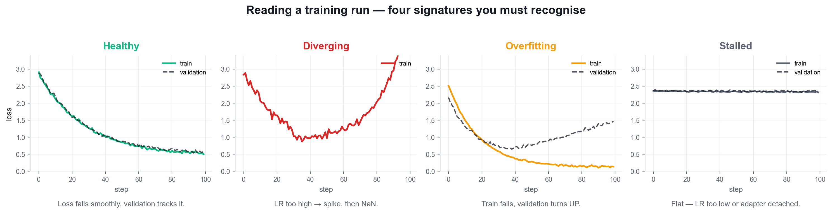
LU3 · STABILITY AND CONVERGENCE
Reading a Training Run
Four signatures you must be able to name on sight. Diagnosis comes before any change to the configuration.
Fine Tuning Open Source LLM · C922
© 2026 Tertiary Infotech Academy Pte Ltd
106

Slide 107
LU3 · TROUBLESHOOTING
Training Failure Modes and Their Fixes
Symptom
Likely cause
The fix
Loss → NaN or Inf
LR too high, or fp16 overflow
Lower LR 10×, use bf16, clip grad to 1.0
Loss spikes then recovers
Bad batch or LR slightly high
Clip gradients, add warmup steps
Loss completely flat
LR too low / adapter not attached
Raise LR; check print_trainable_parameters
Val loss rises, train falls
Overfitting
Fewer epochs, early stopping, more data
Gradient norm > 10
Unstable updates
max_grad_norm = 1.0, lower the LR
CUDA out of memory
Batch or sequence too large
Lower batch, raise grad accumulation
WHEN IT MATTERS Diagnose from the CURVE, not from the final number. A single loss value cannot distinguish overfitting from healthy convergence.
Fine Tuning Open Source LLM · C922
© 2026 Tertiary Infotech Academy Pte Ltd
107

Slide 108
LU3 · TUNE IN THIS ORDER
Hyperparameter Priority Order
1 · Learning rate
By far the most sensitive. 1e-4 to 2e-4 for LoRA — roughly 10× a full fine-tune.
2 · Epochs
1–3 for most datasets. More epochs on a small set buys overfitting, not quality.
1
2
3 · Rank r and alpha
r = 8–16 for style; 32–64 for new skills. alpha = 2r is a sound default.
4 · target_modules
All linear layers. This is a quality decision more than a cost decision.
3
4
5 · Effective batch size
batch × grad_accum × devices. Accumulation buys a large batch on small VRAM.
6 · Everything else
Warmup, weight decay, scheduler — these rarely decide the outcome.
5
6
Fine Tuning Open Source LLM · C922
© 2026 Tertiary Infotech Academy Pte Ltd
108

Slide 109
LU3 · WORKED EXAMPLE
The Training Configuration, Line by Line
These are the settings you will tune in the labs — know why each value is what it is.
args = SFTConfig(
per_device_train_batch_size = 2,
gradient_accumulation_steps = 4, # eff. batch 8
num_train_epochs = 2,
learning_rate = 2e-4,
warmup_steps = 5,
optim = 'adamw_8bit',
lr_scheduler_type = 'linear',
weight_decay = 0.01,
max_grad_norm = 1.0,
bf16 = is_bfloat16_supported(),
seed = 3407,
)
2e-4 learning rate
~10× a full fine-tune, because the adapter is small and starts from zero.
Effective batch 8
batch 2 × accumulation 4. Accumulation trades wall-clock time for VRAM.
adamw_8bit
Quantised optimiser state — a large memory saving for no measurable quality cost.
max_grad_norm 1.0
Gradient clipping: the single most effective guard against divergence.
Fine Tuning Open Source LLM · C922
© 2026 Tertiary Infotech Academy Pte Ltd
109

Slide 110
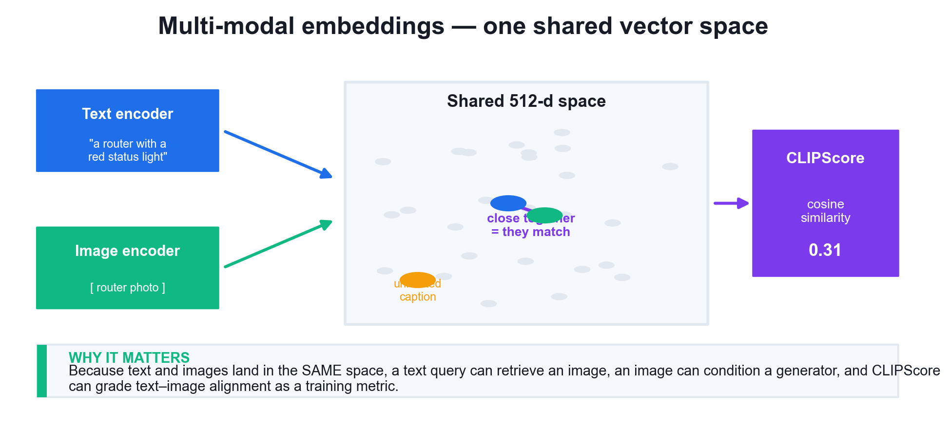
LU3 · ONE SHARED SPACE
Multi-Modal Embeddings
A contrastive objective places text and images in one vector space, so a text query can retrieve an image and CLIPScore can grade alignment.
Fine Tuning Open Source LLM · C922
© 2026 Tertiary Infotech Academy Pte Ltd
110

Slide 111
LU3 · ADVANCED LOSS METRICS
Which Metric for Which Generative Task
Task
Loss
Metric
Direction
The catch
Language modelling
Cross-entropy
Perplexity
lower
Blind to factual accuracy
Translation
Cross-entropy
BLEU / chrF
higher
Punishes valid paraphrase
Summarisation
Cross-entropy
ROUGE-1/2/L
higher
Recall-biased; rewards copying
Open-ended text
Cross-entropy
BERTScore + LLM judge
higher
Judge needs human validation
Image generation
Diffusion MSE
FID
lower
Needs thousands of samples
Text-to-image
Diffusion MSE
CLIPScore
higher
Alignment, not image quality
WHEN IT MATTERS Using an invalid metric for the task is the most common evaluation error. Perplexity in particular can rate a fluent-but-wrong answer above a correct one.
Fine Tuning Open Source LLM · C922
© 2026 Tertiary Infotech Academy Pte Ltd
111

Slide 112
LU3 · LOSS FUNCTIONS
Three Objectives Behind the Three Architectures
Cross-entropy
Autoregressive models. Maximise the likelihood of the next token. Stable, well understood.
Adversarial loss
GANs. Generator and discriminator play a minimax game — powerful but hard to balance.
1
2
Diffusion MSE
Diffusion models. Predict the noise that was added. One simple loss, hence very stable.
InfoNCE contrastive
CLIP-style multi-modal models. Pull matched pairs together, push others apart.
3
4
Fine Tuning Open Source LLM · C922
© 2026 Tertiary Infotech Academy Pte Ltd
112

Slide 113
LU3 · ADAPTATION STRATEGIES
Intermediate Fine Tuning vs Continuous Pre-Training
Strategy
Objective
Data
What it adds
Use when
Task fine tuning
Supervised
Small labelled set
Behaviour, format, style
You have target examples
Intermediate fine tuning
Supervised ×2
Large related, then task
Domain competence first
Task data is scarce
Continuous pre-training
Self-supervised
Large RAW domain text
Domain knowledge, vocabulary
The domain language is unfamiliar
WHEN IT MATTERS The recommended sequence when all three are available: continuous pre-training, then intermediate fine tuning, then task fine tuning on the small target set.
Fine Tuning Open Source LLM · C922
© 2026 Tertiary Infotech Academy Pte Ltd
113

Slide 114
WHAT YOU'LL DO
Hands-On Labs — Modelling
Labs 13–15
Labs 16–18
Labs 19–20
• Frame the Problem and Select the Adaptation Method
• Build LoRA from First Principles
• Fine-Tune with PEFT LoRA
• Fine-Tune with QLoRA in 4-Bit
• Accelerate Fine Tuning with Unsloth
• Monitor Training Stability and Convergence
• Hyperparameter Optimization for LoRA
• Advanced Loss Functions and Generative Metrics
Fine Tuning Open Source LLM · C922
© 2026 Tertiary Infotech Academy Pte Ltd
114

Slide 115
LU3 · HANDS-ON · SELF-PACED
Frame the Problem and Select the Adaptation Method
LAB 13
Frame a business problem as a fine-tuning problem and justify the adaptation method
Before touching a GPU, decide whether the problem needs prompt engineering, RAG or fine tuning. You test all three on the same business case, measure the result, and produce a written justification — including the multi-modal embedding case where the input is not text alone.
YOU'LL BUILD
TOOLCHAIN
DONE WHEN
A decision record that tests prompting, RAG and fine tuning on one problem with measured results, plus a multi-modal embedding demonstration showing when a shared vector space is needed.
Unsloth, sentence-transformers, CLIP, scikit-learn, pandas
All three options produce output on the same ticket, the option comparison table is printed, CLIP scores the correct caption highest, and adaptation_decision.json records the chosen method with an explicit justification against the stated constraints.
Fine Tuning Open Source LLM · C922
© 2026 Tertiary Infotech Academy Pte Ltd
115

Slide 116
LAB 13 · THE SHAPE OF IT
How Lab 13 Runs
1
2
3
4
5
State the business problem
Test prompt engineering
Test retrieval (RAG)
Compare against constraints
Embed text and image
problem statement
Unsloth inference
sentence-transformers
option scoring table
open_clip · CLIP
THE POINT
Frame a business problem as a fine-tuning problem and justify the adaptation method
Fine Tuning Open Source LLM · C922
© 2026 Tertiary Infotech Academy Pte Ltd
116

Slide 117
LAB 13 · VERIFY
Frame the Problem and Select the Adaptation Method
✅ Expected result
All three options produce output on the same ticket, the option comparison table is printed, CLIP scores the correct caption highest, and adaptation_decision.json records the chosen method with an explicit justification against the stated constraints.
IF IT DOESN'T WORK
CUDA out of memory
No GPU attached
ModuleNotFoundError
Restart the runtime, lower per_device_train_batch_size, raise gradient_accumulation_steps.
Runtime > Change runtime type > T4 GPU, then re-run from the first cell.
Re-run the pip install cell; on Colab, restart the session after installing unsloth.
Fine Tuning Open Source LLM · C922
© 2026 Tertiary Infotech Academy Pte Ltd
117

Slide 118
LU3 · HANDS-ON · SELF-PACED
Build LoRA from First Principles
LAB 14
Implement the LoRA low-rank decomposition and verify its parameter and memory savings
Implement LoRA yourself in about thirty lines of PyTorch — the low-rank update h = Wx + (alpha/r)BAx — then prove the three properties that make it work: zero-initialised B means an identity start, the parameter count collapses with r, and the merged weight is mathematically identical to the adapted forward pass.
YOU'LL BUILD
TOOLCHAIN
DONE WHEN
A working LoRALinear layer, a parameter-count table across ranks, and a numerical proof that merging BA into W reproduces the adapted output exactly.
PyTorch, numpy, matplotlib
The identity-at-init assertion passes (difference < 1e-6), the parameter table shows LoRA at well under 5% of full parameters for r<=16, the merge assertion passes (error < 1e-4), and lora_param_scaling.png is produced.
Fine Tuning Open Source LLM · C922
© 2026 Tertiary Infotech Academy Pte Ltd
118

Slide 119
LAB 14 · THE SHAPE OF IT
How Lab 14 Runs
1
2
3
4
5
Start from a plain linear layer
Implement the LoRA layer
Prove it starts as a no-op
Count the parameter collapse
Prove merging is exact
PyTorch nn.Linear
A, B and alpha/r
B initialised to zero
r(d_in+d_out)
W + (alpha/r)BA
THE POINT
Implement the LoRA low-rank decomposition and verify its parameter and memory savings
Fine Tuning Open Source LLM · C922
© 2026 Tertiary Infotech Academy Pte Ltd
119

Slide 120
LAB 14 · VERIFY
Build LoRA from First Principles
✅ Expected result
The identity-at-init assertion passes (difference < 1e-6), the parameter table shows LoRA at well under 5% of full parameters for r<=16, the merge assertion passes (error < 1e-4), and lora_param_scaling.png is produced.
IF IT DOESN'T WORK
CUDA out of memory
No GPU attached
ModuleNotFoundError
Restart the runtime, lower per_device_train_batch_size, raise gradient_accumulation_steps.
Runtime > Change runtime type > T4 GPU, then re-run from the first cell.
Re-run the pip install cell; on Colab, restart the session after installing unsloth.
Fine Tuning Open Source LLM · C922
© 2026 Tertiary Infotech Academy Pte Ltd
120

Slide 121
LU3 · HANDS-ON · IN CLASS
Fine-Tune with PEFT LoRA
LAB 15
Fine-tune a pre-trained model with the PEFT LoRA implementation
Run a real LoRA fine-tune with the Hugging Face PEFT library on the dataset built in LU1 and LU2: configure LoraConfig, inspect the trainable parameter count, train with SFTTrainer, and compare the base and adapted model on held-out prompts.
YOU'LL BUILD
TOOLCHAIN
DONE WHEN
A trained LoRA adapter of a few tens of megabytes, a training-loss curve, and a side-by-side before/after comparison on held-out prompts.
Hugging Face PEFT, transformers, TRL SFTTrainer, bitsandbytes, datasets
print_trainable_parameters() reports under 1% trainable, the training loss falls from its starting value, peft_loss_curve.png shows a descending curve, the after-generation differs visibly from the before, and lora_adapter/ is only tens of megabytes.
Fine Tuning Open Source LLM · C922
© 2026 Tertiary Infotech Academy Pte Ltd
121

Slide 122
LAB 15 · THE SHAPE OF IT
How Lab 15 Runs
1
2
3
4
5
Load the base model in 4-bit
Inspect the module names
Configure LoRA on all layers
Confirm the trainable fraction
Train and compare before/after
BitsAndBytesConfig
named_modules
peft LoraConfig
under 1%
TRL SFTTrainer
THE POINT
Fine-tune a pre-trained model with the PEFT LoRA implementation
Fine Tuning Open Source LLM · C922
© 2026 Tertiary Infotech Academy Pte Ltd
122

Slide 123
LAB 15 · VERIFY
Fine-Tune with PEFT LoRA
✅ Expected result
print_trainable_parameters() reports under 1% trainable, the training loss falls from its starting value, peft_loss_curve.png shows a descending curve, the after-generation differs visibly from the before, and lora_adapter/ is only tens of megabytes.
IF IT DOESN'T WORK
CUDA out of memory
No GPU attached
ModuleNotFoundError
Restart the runtime, lower per_device_train_batch_size, raise gradient_accumulation_steps.
Runtime > Change runtime type > T4 GPU, then re-run from the first cell.
Re-run the pip install cell; on Colab, restart the session after installing unsloth.
Fine Tuning Open Source LLM · C922
© 2026 Tertiary Infotech Academy Pte Ltd
123

Slide 124
LU3 · HANDS-ON · SELF-PACED
Fine-Tune with QLoRA in 4-Bit
LAB 16
Apply QLoRA 4-bit quantisation and measure the memory saving against LoRA
Quantify what QLoRA actually buys. You measure the VRAM of the same model at 16-bit, 8-bit and 4-bit NF4, inspect the effect of double quantisation and paged optimisers, fine-tune in 4-bit, and compare the resulting quality against the 16-bit LoRA run.
YOU'LL BUILD
TOOLCHAIN
DONE WHEN
A memory-comparison table across three precisions with measured VRAM, a QLoRA fine-tune that fits in a free Colab session, and a quality comparison against the LoRA baseline.
bitsandbytes, PEFT, transformers, TRL, torch
quantisation_memory.csv shows 4-bit using substantially less VRAM than 16-bit, the parameter dump shows Params4bit storage with a bf16 adapter, the QLoRA training completes with peak VRAM reported, and qlora_adapter/ is saved.
Fine Tuning Open Source LLM · C922
© 2026 Tertiary Infotech Academy Pte Ltd
124

Slide 125
LAB 16 · THE SHAPE OF IT
How Lab 16 Runs
1
2
3
4
5
Measure the model at 16-bit
Measure 8-bit and 4-bit
Add double quantisation
Attach the adapter on top
Train with a paged optimiser
bf16 baseline
bitsandbytes NF4
further VRAM saving
bf16 adapter
paged_adamw_8bit
THE POINT
Apply QLoRA 4-bit quantisation and measure the memory saving against LoRA
Fine Tuning Open Source LLM · C922
© 2026 Tertiary Infotech Academy Pte Ltd
125

Slide 126
LAB 16 · VERIFY
Fine-Tune with QLoRA in 4-Bit
✅ Expected result
quantisation_memory.csv shows 4-bit using substantially less VRAM than 16-bit, the parameter dump shows Params4bit storage with a bf16 adapter, the QLoRA training completes with peak VRAM reported, and qlora_adapter/ is saved.
IF IT DOESN'T WORK
CUDA out of memory
No GPU attached
ModuleNotFoundError
Restart the runtime, lower per_device_train_batch_size, raise gradient_accumulation_steps.
Runtime > Change runtime type > T4 GPU, then re-run from the first cell.
Re-run the pip install cell; on Colab, restart the session after installing unsloth.
Fine Tuning Open Source LLM · C922
© 2026 Tertiary Infotech Academy Pte Ltd
126

Slide 127
LU3 · HANDS-ON · IN CLASS
Accelerate Fine Tuning with Unsloth
LAB 17
Use Unsloth to fine-tune faster and with less memory, and verify the speed-up
Run the same fine-tune through Unsloth's optimised kernels and measure the difference against the plain PEFT run: training time, peak VRAM and final loss. You then use the Unsloth chat templates and response-only training that the standard loop makes awkward.
YOU'LL BUILD
TOOLCHAIN
DONE WHEN
A benchmark table comparing Unsloth against standard PEFT on time, memory and loss, plus a trained adapter produced by the Unsloth pipeline.
Unsloth FastLanguageModel, TRL SFTTrainer, Triton kernels, datasets
The training completes and reports runtime, peak reserved VRAM and the memory used for training; the response-only masking reports a non-zero count of masked prompt tokens; unsloth_benchmark.csv compares Unsloth against the PEFT run; and unsloth_adapter/ is saved.
Fine Tuning Open Source LLM · C922
© 2026 Tertiary Infotech Academy Pte Ltd
127

Slide 128
LAB 17 · THE SHAPE OF IT
How Lab 17 Runs
1
2
3
4
5
Load through Unsloth
Attach LoRA the Unsloth way
Apply the chat template
Train on the response only
Benchmark against plain PEFT
FastLanguageModel
get_peft_model
get_chat_template
prompt tokens masked
unsloth_benchmark.csv
THE POINT
Use Unsloth to fine-tune faster and with less memory, and verify the speed-up
Fine Tuning Open Source LLM · C922
© 2026 Tertiary Infotech Academy Pte Ltd
128

Slide 129
LAB 17 · VERIFY
Accelerate Fine Tuning with Unsloth
✅ Expected result
The training completes and reports runtime, peak reserved VRAM and the memory used for training; the response-only masking reports a non-zero count of masked prompt tokens; unsloth_benchmark.csv compares Unsloth against the PEFT run; and unsloth_adapter/ is saved.
IF IT DOESN'T WORK
CUDA out of memory
No GPU attached
ModuleNotFoundError
Restart the runtime, lower per_device_train_batch_size, raise gradient_accumulation_steps.
Runtime > Change runtime type > T4 GPU, then re-run from the first cell.
Re-run the pip install cell; on Colab, restart the session after installing unsloth.
Fine Tuning Open Source LLM · C922
© 2026 Tertiary Infotech Academy Pte Ltd
129

Slide 130
LU3 · HANDS-ON · SELF-PACED
Monitor Training Stability and Convergence
LAB 18
Monitor a generative training run for stability and convergence, and correct failures
Learn to read a training run. You instrument loss, gradient norm, learning rate and VRAM with a custom callback, then deliberately induce the three classic failures — divergence, overfitting and a stalled run — recognise each signature and apply the correct fix.
YOU'LL BUILD
TOOLCHAIN
DONE WHEN
A monitoring callback producing a four-panel diagnostic dashboard, plus three reproduced failure modes each with its identified signature and applied correction.
TRL SFTTrainer, transformers TrainerCallback, matplotlib, torch
monitor_healthy.png, monitor_diverged.png, monitor_overfit.png and monitor_stalled.png are all produced; diagnose() correctly labels the healthy run HEALTHY and each broken run with its specific failure; and training_troubleshooting.csv maps every symptom to a fix.
Fine Tuning Open Source LLM · C922
© 2026 Tertiary Infotech Academy Pte Ltd
130

Slide 131
LAB 18 · THE SHAPE OF IT
How Lab 18 Runs
1
2
3
4
5
Instrument the training run
Establish a healthy baseline
Induce divergence
Induce overfitting
Map each symptom to a fix
TrainerCallback
loss + grad norm
learning rate too high
too many epochs
troubleshooting table
THE POINT
Monitor a generative training run for stability and convergence, and correct failures
Fine Tuning Open Source LLM · C922
© 2026 Tertiary Infotech Academy Pte Ltd
131

Slide 132
LAB 18 · VERIFY
Monitor Training Stability and Convergence
✅ Expected result
monitor_healthy.png, monitor_diverged.png, monitor_overfit.png and monitor_stalled.png are all produced; diagnose() correctly labels the healthy run HEALTHY and each broken run with its specific failure; and training_troubleshooting.csv maps every symptom to a fix.
IF IT DOESN'T WORK
CUDA out of memory
No GPU attached
ModuleNotFoundError
Restart the runtime, lower per_device_train_batch_size, raise gradient_accumulation_steps.
Runtime > Change runtime type > T4 GPU, then re-run from the first cell.
Re-run the pip install cell; on Colab, restart the session after installing unsloth.
Fine Tuning Open Source LLM · C922
© 2026 Tertiary Infotech Academy Pte Ltd
132

Slide 133
LU3 · HANDS-ON · SELF-PACED
Hyperparameter Optimization for LoRA
LAB 19
Perform hyperparameter optimization and select a configuration on measured evidence
Run a systematic hyperparameter search in the correct priority order — learning rate, then rank and alpha, then target modules, then epochs and effective batch size — measuring validation loss for each configuration and selecting the winner on evidence.
YOU'LL BUILD
TOOLCHAIN
DONE WHEN
A hyperparameter sweep table with validation loss per configuration, sensitivity plots, and a selected configuration saved as best_hyperparameters.json.
Unsloth, TRL SFTTrainer, pandas, matplotlib, numpy
hpo_sweep.csv records every trial with its validation loss; hpo_sensitivity.png shows all four sensitivity curves; the target-module comparison shows 'all' beating 'attn_only'; and best_hyperparameters.json holds the selected configuration.
Fine Tuning Open Source LLM · C922
© 2026 Tertiary Infotech Academy Pte Ltd
133

Slide 134
LAB 19 · THE SHAPE OF IT
How Lab 19 Runs
1
2
3
4
5
Build a repeatable trial
Sweep the learning rate
Sweep the rank r
Sweep the target modules
Save the winning config
one config per run
most sensitive first
capacity vs cost
attention vs all linear
best_hyperparameters.json
THE POINT
Perform hyperparameter optimization and select a configuration on measured evidence
Fine Tuning Open Source LLM · C922
© 2026 Tertiary Infotech Academy Pte Ltd
134

Slide 135
LAB 19 · VERIFY
Hyperparameter Optimization for LoRA
✅ Expected result
hpo_sweep.csv records every trial with its validation loss; hpo_sensitivity.png shows all four sensitivity curves; the target-module comparison shows 'all' beating 'attn_only'; and best_hyperparameters.json holds the selected configuration.
IF IT DOESN'T WORK
CUDA out of memory
No GPU attached
ModuleNotFoundError
Restart the runtime, lower per_device_train_batch_size, raise gradient_accumulation_steps.
Runtime > Change runtime type > T4 GPU, then re-run from the first cell.
Re-run the pip install cell; on Colab, restart the session after installing unsloth.
Fine Tuning Open Source LLM · C922
© 2026 Tertiary Infotech Academy Pte Ltd
135

Slide 136
LU3 · HANDS-ON · SELF-PACED
Advanced Loss Functions and Generative Metrics
LAB 20
Apply advanced loss functions and metrics for evaluating generative performance
Implement and interpret the loss functions and metrics that generative models are actually judged on: cross-entropy and perplexity, BLEU/ROUGE/BERTScore for text, FID and Inception Score for images, CLIPScore for text-image alignment, and the contrastive and diffusion objectives.
YOU'LL BUILD
TOOLCHAIN
DONE WHEN
A metric toolkit with each measure implemented and demonstrated on real outputs, plus a selection guide mapping each generative task to the metrics that are valid for it.
PyTorch, Hugging Face evaluate, torchmetrics, CLIP, scipy, numpy
Perplexity is lower for well-formed than for shuffled text; BERTScore rates the paraphrase higher than BLEU does; FID is lower for the near-real images than the unrelated ones; CLIPScore is higher for the correct caption; and metric_selection_guide.csv is written.
Fine Tuning Open Source LLM · C922
© 2026 Tertiary Infotech Academy Pte Ltd
136

Slide 137
LAB 20 · THE SHAPE OF IT
How Lab 20 Runs
1
2
3
4
5
Measure cross-entropy and PPL
Score BLEU and ROUGE
Score BERTScore semantics
Compute FID for images
Score text-image alignment
language modelling loss
evaluate library
recognises paraphrase
torchmetrics
CLIPScore
THE POINT
Apply advanced loss functions and metrics for evaluating generative performance
Fine Tuning Open Source LLM · C922
© 2026 Tertiary Infotech Academy Pte Ltd
137

Slide 138
LAB 20 · VERIFY
Advanced Loss Functions and Generative Metrics
✅ Expected result
Perplexity is lower for well-formed than for shuffled text; BERTScore rates the paraphrase higher than BLEU does; FID is lower for the near-real images than the unrelated ones; CLIPScore is higher for the correct caption; and metric_selection_guide.csv is written.
IF IT DOESN'T WORK
CUDA out of memory
No GPU attached
ModuleNotFoundError
Restart the runtime, lower per_device_train_batch_size, raise gradient_accumulation_steps.
Runtime > Change runtime type > T4 GPU, then re-run from the first cell.
Re-run the pip install cell; on Colab, restart the session after installing unsloth.
Fine Tuning Open Source LLM · C922
© 2026 Tertiary Infotech Academy Pte Ltd
138

Slide 139
LU3 · WHAT YOU CAN NOW DO
Recap — Modelling
Lab 13
Frame a business problem as a fine-tuning problem and justify the adaptation method
Lab 14
Implement the LoRA low-rank decomposition and verify its parameter and memory savings
1
2
Lab 15
Fine-tune a pre-trained model with the PEFT LoRA implementation
Lab 16
Apply QLoRA 4-bit quantisation and measure the memory saving against LoRA
3
4
Lab 17
Use Unsloth to fine-tune faster and with less memory, and verify the speed-up
Lab 18
Monitor a generative training run for stability and convergence, and correct failures
5
6
Fine Tuning Open Source LLM · C922
© 2026 Tertiary Infotech Academy Pte Ltd
139

Slide 140
LU3 · WHAT GOES WRONG
Common Mistakes — Modelling
Targeting attention only
q_proj and v_proj alone underfit badly. Include the MLP gate/up/down projections.
Copying a learning rate from a blog
2e-4 suits LoRA on a small set; the right value depends on your data and rank.
1
2
Too many epochs
On a small dataset this buys overfitting, not quality. Watch the validation curve.
Reading one loss number
A single value cannot distinguish healthy convergence from overfitting — read the curve.
3
4
Raising rank to fix quality
Validation loss usually saturates by r=16. If quality is poor, look at the DATA first.
No validation split
Without one, overfitting is invisible until the model reaches production.
5
6
Fine Tuning Open Source LLM · C922
© 2026 Tertiary Infotech Academy Pte Ltd
140

Slide 141
04
LEARNING UNIT 04
Machine Learning Implementation and Operations
Benchmarking against state of the art · explainability and interpretability · bias and fairness · continuous pre-training pipelines · deployment
Fine Tuning Open Source LLM · C922
© 2026 Tertiary Infotech Academy Pte Ltd
141

Slide 142
LU4 · ORIENTATION
LU4 at a Glance
1
Learning outcome
Analyse ML solutions for bias, explainability, and alignment with performance benchmarks.
2
Hands-on labs
Lab 21 in class · Labs 22–26 self-paced
3
Weighting
20% of course time · Late afternoon
4
Topics
Build and benchmark generative solutions against state of the art · Recommend and implement bias mitigation and fairness interventions · Apply interpretability and explainability methods · Deploy and operationalize fine-tuned models
Fine Tuning Open Source LLM · C922
© 2026 Tertiary Infotech Academy Pte Ltd
142

Slide 143
LU4 · WEIGHTING 20%
Key Concepts — Machine Learning Implementation and Operations
1
Benchmarking against state of the art needs a held-out set the model has never seen, a fixed decoding configuration, the same prompt template for every system, and more than one metric.
2
Standard public benchmarks — MMLU for knowledge, GSM8K for reasoning, HumanEval for code, HELM and the Open LLM Leaderboard for breadth — provide comparison points, but a domain-specific held-out set is what actually predicts production performance.
3
LLM-as-a-judge scores open-ended generation on correctness, helpfulness and format at a fraction of human cost, but must be validated against human labels and controlled for position bias.
4
Always benchmark against the base model, not only against the previous fine-tune — a fine-tune that beats its predecessor but loses to the base model is a regression.
Fine Tuning Open Source LLM · C922
© 2026 Tertiary Infotech Academy Pte Ltd
143

Slide 144
LU4 · WEIGHTING 20%
Key Concepts — Machine Learning Implementation and Operations (2)
1
Catastrophic forgetting is measured, not assumed: re-run a general benchmark after fine tuning to confirm the model has not lost its original capability.
2
Interpretability and explainability for generative models: attention visualisation, integrated gradients and SHAP for token attribution, probing classifiers for what a layer encodes, and chain-of-thought as a (partial) behavioural explanation.
3
Attention weights show where the model looked, not why it decided — treat attention maps as a hypothesis-generating tool, not a causal proof.
4
Sources of bias in generative models: the pre-training corpus, the fine-tuning set, annotator judgement, the objective function itself, and deployment feedback loops that amplify whatever the model already prefers.
Fine Tuning Open Source LLM · C922
© 2026 Tertiary Infotech Academy Pte Ltd
144

Slide 145
LU4 · WEIGHTING 20%
Key Concepts — Machine Learning Implementation and Operations (3)
1
Fairness-enhancing interventions act at three stages — pre-processing (rebalance and augment the data), in-processing (counterfactual data augmentation, fairness-regularised or preference objectives), and post-processing (output filters, safety classifiers, guardrails).
2
Counterfactual evaluation swaps demographic attributes in an otherwise identical prompt and measures the change in the output — a large change is direct evidence of bias.
3
Continuous pre-training pipelines resume from an existing checkpoint on new raw domain text, with a low learning rate, a replay mixture of the original data and regular general-benchmark checks to guard against forgetting.
4
Checkpoint hygiene makes a pipeline restartable: save optimizer and scheduler state alongside weights, version every checkpoint against its dataset revision, and validate each cycle before promoting it.
Fine Tuning Open Source LLM · C922
© 2026 Tertiary Infotech Academy Pte Ltd
145

Slide 146
LU4 · WEIGHTING 20%
Key Concepts — Machine Learning Implementation and Operations (4)
Deployment: merge to 16-bit for a GPU server (vLLM), export GGUF q4_k_m for CPU/local serving (llama.cpp, Ollama), or keep the adapter separate and hot-swap it per tenant.
1
Model cards and dataset cards document intended use, training data, evaluation results and known limitations — they are the governance artifact that makes a fine-tune auditable.
2
Fine Tuning Open Source LLM · C922
© 2026 Tertiary Infotech Academy Pte Ltd
146

Slide 147
LU4 · SIX RULES
Benchmarking That Means Something
A held-out set
Data the model has NEVER seen. Benchmarking on training data flatters and misleads.
A fixed decoder
Same temperature, top-p and max tokens for every system compared.
1
2
The same prompt template
A template difference alone can move a score by several points.
More than one metric
Every metric is blind to a different failure.
3
4
The BASE model as control
A fine-tune that loses to its own base model is a regression.
A forgetting check
Re-run a general benchmark — measure what the fine-tune cost you elsewhere.
5
6
Fine Tuning Open Source LLM · C922
© 2026 Tertiary Infotech Academy Pte Ltd
147

Slide 148
LU4 · THE CONTROL
Always benchmark against the base model, not only the previous fine-tune.
A model that beats its predecessor but loses to the untouched base model is a regression that a leaderboard of your own runs will never reveal.
Fine Tuning Open Source LLM · C922
© 2026 Tertiary Infotech Academy Pte Ltd
148

Slide 149
LU4 · EXPLAINABILITY
Interpretability Methods and Their Limits
Attention visualisation
Shows where each head LOOKED. Correlational — a high weight is not proof of influence.
Integrated gradients
Causal attribution to input tokens. Depends on the baseline; expensive on long text.
1
2
Probing classifiers
Finds WHERE a property becomes decodable. Decodable does not mean the model uses it.
Behavioural ablation
Remove a token, measure the change. Ignores interactions between tokens.
3
4
Chain of thought
A stated reason — but not necessarily the actual computation.
Model cards
The governance artifact: intended use, data, evaluation and known limitations.
5
6
Fine Tuning Open Source LLM · C922
© 2026 Tertiary Infotech Academy Pte Ltd
149

Slide 150
LU4 · THE LIMIT
Attention shows where the model looked. It does not show why it decided.
Use at least two methods before making a claim to a regulator. An explanation supported only by an attention map is not defensible.
Fine Tuning Open Source LLM · C922
© 2026 Tertiary Infotech Academy Pte Ltd
150

Slide 151
LU4 · WHERE BIAS COMES FROM
Five Sources of Bias in Generative Models
Pre-training corpus
Web-scale text carries historical and demographic skew into every downstream model.
Fine-tuning dataset
Whatever you chose to include — and whatever you failed to include.
1
2
Annotator judgement
Who wrote the reference answers, and what did they consider a good answer?
Objective function
Maximum likelihood optimises for the majority pattern, not for fairness.
3
4
Deployment feedback loop
The model's own outputs become tomorrow's training data, amplifying its preferences.
5
Fine Tuning Open Source LLM · C922
© 2026 Tertiary Infotech Academy Pte Ltd
151

Slide 152
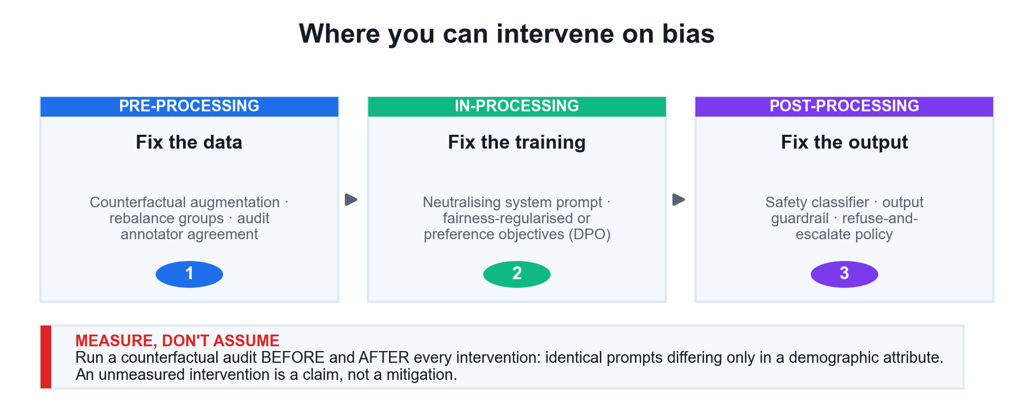
LU4 · THREE STAGES
Where You Can Intervene on Bias
Counterfactual testing before and after every intervention is what turns a claim into a mitigation.
Fine Tuning Open Source LLM · C922
© 2026 Tertiary Infotech Academy Pte Ltd
152

Slide 153
LU4 · THE PIPELINE
A Continuous Pre-Training Cycle
1
2
3
4
5
New domain text
Mix in replay
Resume checkpoint
Validate
Accept or reject
arrives weekly
~15% general data
optimiser state too
domain AND general
promote only if safe
WHAT MAKES IT RESTARTABLE
Saving optimiser and scheduler state alongside the weights, and versioning every checkpoint against its dataset revision.
Fine Tuning Open Source LLM · C922
© 2026 Tertiary Infotech Academy Pte Ltd
153

Slide 154
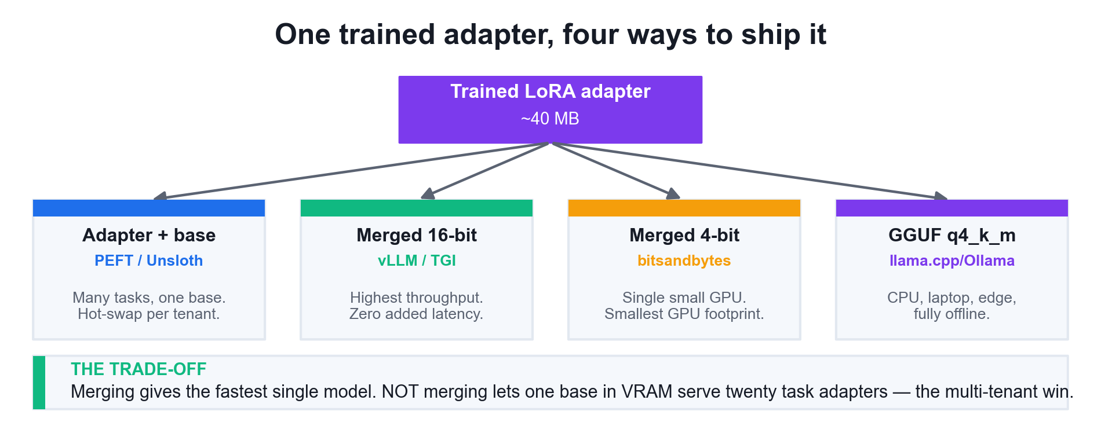
LU4 · DEPLOYMENT
One Adapter, Four Ways to Ship It
Merging gives the fastest single model. NOT merging lets one base in VRAM serve twenty task adapters — the multi-tenant win.
Fine Tuning Open Source LLM · C922
© 2026 Tertiary Infotech Academy Pte Ltd
154

Slide 155
WHAT YOU'LL DO
Hands-On Labs — Machine Learning Implementation and Operations
Labs 21–22
Labs 23–24
Labs 25–26
• Benchmark the Fine-Tuned Model Against State of the Art
• Detect and Mitigate Bias in Generative Outputs
• Interpretability and Explainability for Generative Models
• Intermediate Fine Tuning and Continuous Pre-Training
• Merge, Export and Deploy the Fine-Tuned Model
• Capstone — End-to-End Fine-Tuning Project
Fine Tuning Open Source LLM · C922
© 2026 Tertiary Infotech Academy Pte Ltd
155

Slide 156
LU4 · HANDS-ON · IN CLASS
Benchmark the Fine-Tuned Model Against State of the Art
LAB 21
Analyse a fine-tuned model against state-of-the-art benchmarks
Run a rigorous benchmark: base model versus fine-tuned model versus a reference model on a held-out set with a fixed decoding configuration, using several metrics plus an LLM judge, and check explicitly for catastrophic forgetting on a general benchmark.
YOU'LL BUILD
TOOLCHAIN
DONE WHEN
A benchmark report comparing three systems on four metrics with a catastrophic-forgetting check, and a recommendation grounded in the measured gap.
Unsloth, PEFT, Hugging Face evaluate, pandas, matplotlib
benchmark_report.json compares base and fine-tuned on ROUGE, BLEU, BERTScore and perplexity under one fixed decoding config; the catastrophic-forgetting check reports a percentage change on general text; and benchmark_comparison.png is produced.
Fine Tuning Open Source LLM · C922
© 2026 Tertiary Infotech Academy Pte Ltd
156

Slide 157
LAB 21 · THE SHAPE OF IT
How Lab 21 Runs
1
2
3
4
5
Load the held-out test set
Generate from the base model
Generate from the fine-tune
Score on several metrics
Check for forgetting
never-seen data
fixed decoder
same decoder
ROUGE · BLEU · BERTScore
general-task perplexity
THE POINT
Analyse a fine-tuned model against state-of-the-art benchmarks
Fine Tuning Open Source LLM · C922
© 2026 Tertiary Infotech Academy Pte Ltd
157

Slide 158
LAB 21 · VERIFY
Benchmark the Fine-Tuned Model Against State of the Art
✅ Expected result
benchmark_report.json compares base and fine-tuned on ROUGE, BLEU, BERTScore and perplexity under one fixed decoding config; the catastrophic-forgetting check reports a percentage change on general text; and benchmark_comparison.png is produced.
IF IT DOESN'T WORK
CUDA out of memory
No GPU attached
ModuleNotFoundError
Restart the runtime, lower per_device_train_batch_size, raise gradient_accumulation_steps.
Runtime > Change runtime type > T4 GPU, then re-run from the first cell.
Re-run the pip install cell; on Colab, restart the session after installing unsloth.
Fine Tuning Open Source LLM · C922
© 2026 Tertiary Infotech Academy Pte Ltd
158

Slide 159
LU4 · HANDS-ON · SELF-PACED
Detect and Mitigate Bias in Generative Outputs
LAB 22
Identify sources of bias and implement fairness-enhancing interventions
Audit a fine-tuned model for demographic bias with counterfactual testing, trace the bias back to its source in the training data, then implement and measure interventions at all three stages — pre-processing, in-processing and post-processing.
YOU'LL BUILD
TOOLCHAIN
DONE WHEN
A counterfactual bias audit with measured disparity before and after intervention, a data-side rebalancing, an output guardrail, and a fairness report.
Unsloth, sentence-transformers, pandas, scipy, matplotlib
The counterfactual audit reports an agentic-language gap and a length t-test p-value before mitigation; debiased_train.jsonl is larger than the original; the guardrail blocks the biased probe and passes the neutral one; bias_mitigation.png and fairness_report.json are produced.
Fine Tuning Open Source LLM · C922
© 2026 Tertiary Infotech Academy Pte Ltd
159

Slide 160
LAB 22 · THE SHAPE OF IT
How Lab 22 Runs
1
2
3
4
5
Build counterfactual prompts
Generate for every group
Measure the disparity
Augment the training data
Re-measure after mitigation
demographics swapped
fixed decoder
agentic language · t-test
counterfactual pairs
fairness_report.json
THE POINT
Identify sources of bias and implement fairness-enhancing interventions
Fine Tuning Open Source LLM · C922
© 2026 Tertiary Infotech Academy Pte Ltd
160

Slide 161
LAB 22 · VERIFY
Detect and Mitigate Bias in Generative Outputs
✅ Expected result
The counterfactual audit reports an agentic-language gap and a length t-test p-value before mitigation; debiased_train.jsonl is larger than the original; the guardrail blocks the biased probe and passes the neutral one; bias_mitigation.png and fairness_report.json are produced.
IF IT DOESN'T WORK
CUDA out of memory
No GPU attached
ModuleNotFoundError
Restart the runtime, lower per_device_train_batch_size, raise gradient_accumulation_steps.
Runtime > Change runtime type > T4 GPU, then re-run from the first cell.
Re-run the pip install cell; on Colab, restart the session after installing unsloth.
Fine Tuning Open Source LLM · C922
© 2026 Tertiary Infotech Academy Pte Ltd
161

Slide 162
LU4 · HANDS-ON · SELF-PACED
Interpretability and Explainability for Generative Models
LAB 23
Apply interpretability and explainability methods to a generative model
Open the model up with four complementary methods — attention visualisation, gradient-based token attribution, a layer probing classifier and behavioural ablation — and understand what each one can and cannot tell a regulator.
YOU'LL BUILD
TOOLCHAIN
DONE WHEN
Four working explainability analyses with plots, plus a written note on the limits of each method — the kind of evidence a compliance officer actually asks for.
PyTorch, transformers, matplotlib, seaborn, scikit-learn
explain_attention.png, explain_attention_vs_ig.png and explain_probing.png are produced; the attention-vs-IG correlation is reported; the probing curve identifies a peak layer above chance; the ablation table ranks the tokens; and explainability_note.json records each method's limits.
Fine Tuning Open Source LLM · C922
© 2026 Tertiary Infotech Academy Pte Ltd
162

Slide 163
LAB 23 · THE SHAPE OF IT
How Lab 23 Runs
1
2
3
4
5
Capture the attention weights
Attribute with gradients
Probe each layer
Ablate input tokens
Record each method's limits
output_attentions
integrated gradients
logistic probe
behavioural test
explainability_note.json
THE POINT
Apply interpretability and explainability methods to a generative model
Fine Tuning Open Source LLM · C922
© 2026 Tertiary Infotech Academy Pte Ltd
163

Slide 164
LAB 23 · VERIFY
Interpretability and Explainability for Generative Models
✅ Expected result
explain_attention.png, explain_attention_vs_ig.png and explain_probing.png are produced; the attention-vs-IG correlation is reported; the probing curve identifies a peak layer above chance; the ablation table ranks the tokens; and explainability_note.json records each method's limits.
IF IT DOESN'T WORK
CUDA out of memory
No GPU attached
ModuleNotFoundError
Restart the runtime, lower per_device_train_batch_size, raise gradient_accumulation_steps.
Runtime > Change runtime type > T4 GPU, then re-run from the first cell.
Re-run the pip install cell; on Colab, restart the session after installing unsloth.
Fine Tuning Open Source LLM · C922
© 2026 Tertiary Infotech Academy Pte Ltd
164

Slide 165
LU4 · HANDS-ON · SELF-PACED
Intermediate Fine Tuning and Continuous Pre-Training
LAB 24
Build a training pipeline that continues pre-training from an existing checkpoint
Distinguish the three adaptation strategies in practice: direct task fine tuning, intermediate fine tuning on a related corpus first, and continuous pre-training on raw domain text. You build a restartable continuous pre-training pipeline with replay data and forgetting checks.
YOU'LL BUILD
TOOLCHAIN
DONE WHEN
A checkpoint-resumable continuous pre-training pipeline with a replay mixture, per-cycle validation and a comparison of the three adaptation strategies on the same held-out set.
Unsloth, TRL SFTTrainer, transformers, datasets, torch
cpt_cycle_log.json records baseline plus two cycles with domain and general perplexity for each; cycle 2 successfully resumes from a saved checkpoint; the replay ratio is reported; and the forgetting guard produces an accept/reject verdict.
Fine Tuning Open Source LLM · C922
© 2026 Tertiary Infotech Academy Pte Ltd
165

Slide 166
LAB 24 · THE SHAPE OF IT
How Lab 24 Runs
1
2
3
4
5
Load the raw domain corpus
Mix in replay data
Adapt embeddings too
Train and validate the cycle
Resume from a checkpoint
unlabelled text
~15% general
embed_tokens · lm_head
domain + general PPL
optimizer state saved
THE POINT
Build a training pipeline that continues pre-training from an existing checkpoint
Fine Tuning Open Source LLM · C922
© 2026 Tertiary Infotech Academy Pte Ltd
166

Slide 167
LAB 24 · VERIFY
Intermediate Fine Tuning and Continuous Pre-Training
✅ Expected result
cpt_cycle_log.json records baseline plus two cycles with domain and general perplexity for each; cycle 2 successfully resumes from a saved checkpoint; the replay ratio is reported; and the forgetting guard produces an accept/reject verdict.
IF IT DOESN'T WORK
CUDA out of memory
No GPU attached
ModuleNotFoundError
Restart the runtime, lower per_device_train_batch_size, raise gradient_accumulation_steps.
Runtime > Change runtime type > T4 GPU, then re-run from the first cell.
Re-run the pip install cell; on Colab, restart the session after installing unsloth.
Fine Tuning Open Source LLM · C922
© 2026 Tertiary Infotech Academy Pte Ltd
167

Slide 168
LU4 · HANDS-ON · SELF-PACED
Merge, Export and Deploy the Fine-Tuned Model
LAB 25
Deploy and operationalize a fine-tuned model across serving targets
Take the adapter to production: merge it into the base weights, verify the merge changed nothing it should not, export to 16-bit and GGUF, benchmark merged versus adapter-only serving, and write the model card that makes the deployment auditable.
YOU'LL BUILD
TOOLCHAIN
DONE WHEN
A merged 16-bit model, a GGUF quantised export, a latency and memory comparison of the serving options, and a completed model card.
Unsloth, PEFT, llama.cpp GGUF, vLLM, Hugging Face Hub
merged_16bit/, merged_4bit/ and gguf_out/ all exist with a .gguf file present; the merged model produces output comparable to the adapter version; deployment_options.csv compares all four serving options by size; and MODEL_CARD.md is written with real measured numbers.
Fine Tuning Open Source LLM · C922
© 2026 Tertiary Infotech Academy Pte Ltd
168

Slide 169
LAB 25 · THE SHAPE OF IT
How Lab 25 Runs
1
2
3
4
5
Load the trained adapter
Merge into 16-bit weights
Verify the merge is faithful
Export GGUF for CPU
Write the model card
unsloth_adapter
save_pretrained_merged
same output
q4_k_m quantisation
MODEL_CARD.md
THE POINT
Deploy and operationalize a fine-tuned model across serving targets
Fine Tuning Open Source LLM · C922
© 2026 Tertiary Infotech Academy Pte Ltd
169

Slide 170
LAB 25 · VERIFY
Merge, Export and Deploy the Fine-Tuned Model
✅ Expected result
merged_16bit/, merged_4bit/ and gguf_out/ all exist with a .gguf file present; the merged model produces output comparable to the adapter version; deployment_options.csv compares all four serving options by size; and MODEL_CARD.md is written with real measured numbers.
IF IT DOESN'T WORK
CUDA out of memory
No GPU attached
ModuleNotFoundError
Restart the runtime, lower per_device_train_batch_size, raise gradient_accumulation_steps.
Runtime > Change runtime type > T4 GPU, then re-run from the first cell.
Re-run the pip install cell; on Colab, restart the session after installing unsloth.
Fine Tuning Open Source LLM · C922
© 2026 Tertiary Infotech Academy Pte Ltd
170

Slide 171
LU4 · HANDS-ON · SELF-PACED
Capstone — End-to-End Fine-Tuning Project
LAB 26
Deliver a complete fine-tuning solution from data to deployment with governance
Put the whole course together on a new domain: build the dataset, fine-tune with a justified configuration, benchmark against the base model, audit for bias, and deliver the model card and deployment artifacts as one reviewable package.
YOU'LL BUILD
TOOLCHAIN
DONE WHEN
A complete, reviewable fine-tuning project: versioned dataset, trained adapter, benchmark report, fairness audit, model card and deployment export.
The full course stack — datasets, Unsloth, PEFT, TRL, evaluate, matplotlib
capstone/PROJECT_REPORT.json records the dataset sizes, the justified method, the training metrics, the benchmark scores and the fairness spread; capstone/adapter/ and capstone/merged_16bit/ both exist; and the quality-gate assertion passed.
Fine Tuning Open Source LLM · C922
© 2026 Tertiary Infotech Academy Pte Ltd
171

Slide 172
LAB 26 · THE SHAPE OF IT
How Lab 26 Runs
1
2
3
4
5
Frame the capstone problem
Build and gate the dataset
Profile and set the length
Fine-tune with your config
Benchmark, audit and ship
success criteria
ETL + quality gate
token percentiles
best_hyperparameters
report + model card
THE POINT
Deliver a complete fine-tuning solution from data to deployment with governance
Fine Tuning Open Source LLM · C922
© 2026 Tertiary Infotech Academy Pte Ltd
172

Slide 173
LAB 26 · VERIFY
Capstone — End-to-End Fine-Tuning Project
✅ Expected result
capstone/PROJECT_REPORT.json records the dataset sizes, the justified method, the training metrics, the benchmark scores and the fairness spread; capstone/adapter/ and capstone/merged_16bit/ both exist; and the quality-gate assertion passed.
IF IT DOESN'T WORK
CUDA out of memory
No GPU attached
ModuleNotFoundError
Restart the runtime, lower per_device_train_batch_size, raise gradient_accumulation_steps.
Runtime > Change runtime type > T4 GPU, then re-run from the first cell.
Re-run the pip install cell; on Colab, restart the session after installing unsloth.
Fine Tuning Open Source LLM · C922
© 2026 Tertiary Infotech Academy Pte Ltd
173

Slide 174
LU4 · WHAT YOU CAN NOW DO
Recap — Machine Learning Implementation and Operations
Lab 21
Analyse a fine-tuned model against state-of-the-art benchmarks
Lab 22
Identify sources of bias and implement fairness-enhancing interventions
1
2
Lab 23
Apply interpretability and explainability methods to a generative model
Lab 24
Build a training pipeline that continues pre-training from an existing checkpoint
3
4
Lab 25
Deploy and operationalize a fine-tuned model across serving targets
Lab 26
Deliver a complete fine-tuning solution from data to deployment with governance
5
6
Fine Tuning Open Source LLM · C922
© 2026 Tertiary Infotech Academy Pte Ltd
174

Slide 175
LU4 · WHAT GOES WRONG
Common Mistakes — Machine Learning Implementation and Operations
Benchmarking on training data
It produces a flattering number that predicts nothing.
Only comparing to the previous fine-tune
A model that beats its predecessor but loses to the base model is a regression.
1
2
Skipping the forgetting check
Domain gains routinely cost general capability. Measure it on a task you did not target.
Claiming fairness without measurement
An unmeasured intervention is a claim, not a mitigation. Run a counterfactual audit.
3
4
Explaining with attention alone
Attention is correlational. Support any regulatory claim with a second, causal method.
Shipping without a model card
Intended use, data, evaluation and limitations — without these the deployment is not auditable.
5
6
Fine Tuning Open Source LLM · C922
© 2026 Tertiary Infotech Academy Pte Ltd
175

Slide 176
WRAP-UP
Course Summary & Next Steps
Fine Tuning Open Source LLM · C922
© 2026 Tertiary Infotech Academy Pte Ltd
176

Slide 177
LEARNING OUTCOMES
What You Achieved
1
LO1 · Ingested and prepared data
Built a versioned data repository, generated synthetic data, ingested from four sources and transformed to the model's chat template.
2
LO2 · Optimised data pipelines
Sanitised a corpus end to end, engineered prompt-side features, built an ETL pipeline with a quality gate, and profiled the dataset.
3
LO3 · Fine-tuned models
Implemented LoRA from first principles, then fine-tuned with PEFT, QLoRA and Unsloth, monitored stability and optimised hyperparameters.
4
LO4 · Analysed for bias and benchmarks
Benchmarked against the base model, audited for demographic bias, applied explainability methods and deployed the result.
Fine Tuning Open Source LLM · C922
© 2026 Tertiary Infotech Academy Pte Ltd
177

Slide 178
THE TAKEAWAYS
The Ten Things to Remember
1
Diagnose before you train
Prompt engineering fixes instructions, RAG fixes facts, fine tuning fixes behaviour.
2
B starts at zero
LoRA begins as an exact no-op and only ever adds to the frozen base.
3
Target ALL linear layers
Attention-only targeting is the most common cause of a disappointing fine-tune.
4
Clean beats big
A thousand curated examples beat a hundred thousand dirty ones.
5
Get the chat template right
A template mismatch trains cleanly and behaves badly. Always append EOS.
6
Learning rate first
2e-4 for LoRA. Tune it before anything else; it dominates every other choice.
7
Read the curve, not the number
Divergence, overfitting and stalling each have a distinct signature.
8
Benchmark against the base
And check for catastrophic forgetting on a task you did not target.
9
Measure bias, don't assume it
Counterfactual testing before and after every intervention.
10
Ship the model card
Intended use, data, evaluation and limitations — or the deployment is not auditable.
Fine Tuning Open Source LLM · C922
© 2026 Tertiary Infotech Academy Pte Ltd
178

Slide 179
NEXT STEPS
Continue Your Learning
Unsloth documentation
https://unsloth.ai/docs — the reference for every FastLanguageModel option.
Hugging Face PEFT
https://huggingface.co/docs/peft — LoRA, DoRA, AdaLoRA and the full adapter family.
1
2
Hugging Face TRL
https://huggingface.co/docs/trl — SFTTrainer, DPO and preference optimisation.
Redo the labs
Rebuild each lab from a blank notebook until the workflow is automatic.
3
4
Fine-tune your own data
Take the capstone pipeline and point it at a dataset from your own work.
Publish it
Push your adapter and model card to the Hugging Face Hub and gather feedback.
5
6
Fine Tuning Open Source LLM · C922
© 2026 Tertiary Infotech Academy Pte Ltd
179

Slide 180
CONTINUE WITH TERTIARY INFOTECH
Recommended Courses
1
Generative AI with Large Language Models
2
Machine Learning with Python
3
Deep Learning with PyTorch
4
Retrieval Augmented Generation (RAG) with LangChain
5
Agentic AI Applications with Claude Code
Fine Tuning Open Source LLM · C922
© 2026 Tertiary Infotech Academy Pte Ltd
180

Slide 181
WE'RE HERE TO HELP
Support
Email
enquiry@tertiaryinfotech.com
Telephone
+65 6100 0613
1
2
Website
www.tertiarycourses.com.sg
LMS / TMS
https://lms-tms.tertiaryinfotech.com
3
4
Course page
www.tertiarycourses.com.sg/fine-tuning-open-source-llm.html
Venue
12 Woodlands Square #07-85/86/87, Singapore 737715
5
6
Fine Tuning Open Source LLM · C922
© 2026 Tertiary Infotech Academy Pte Ltd
181

Slide 182
COURSE FEEDBACK
Course Feedback
Share your feedback
Complete the course-feedback form before you leave today.
Trainer shares the link
The trainer displays the feedback form link and QR code.
1
2
Tell us what worked
Share what worked best and what needs more time.
Certificate of completion
Your e-certificate of completion is issued after the course.
3
4
Fine Tuning Open Source LLM · C922
© 2026 Tertiary Infotech Academy Pte Ltd
182

Slide 183
HAPPY FINE-TUNING
Thank You!
You can now build a fine-tuning dataset, adapt a pre-trained model with LoRA, QLoRA and Unsloth, and evaluate the result for quality, bias and benchmark alignment.
Fine Tuning Open Source LLM · C922
© 2026 Tertiary Infotech Academy Pte Ltd
183

